Slide 1


Slide 2
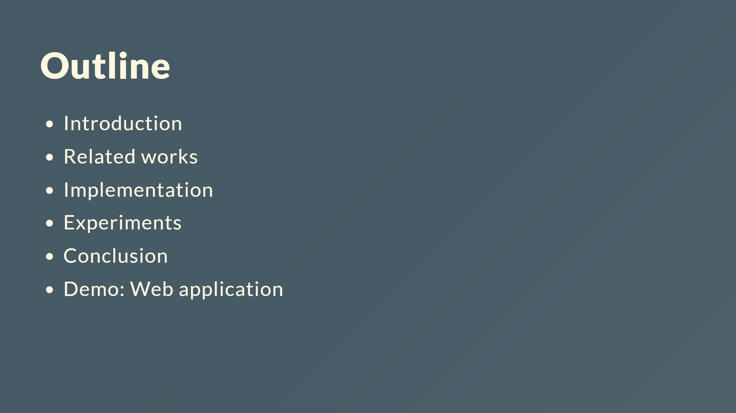

Slide 3
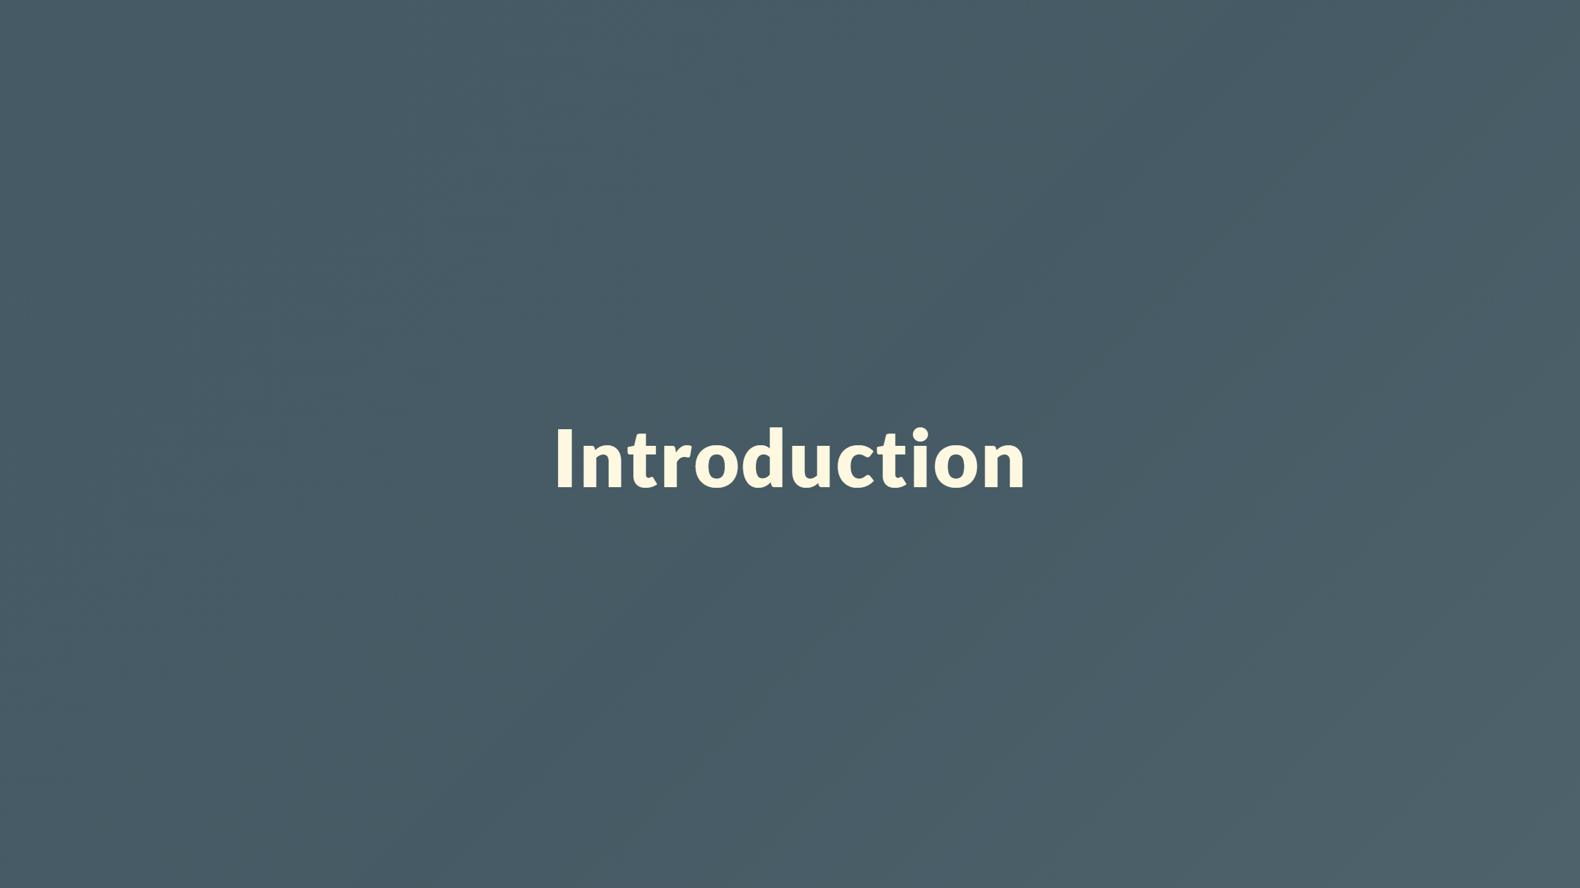

Slide 4
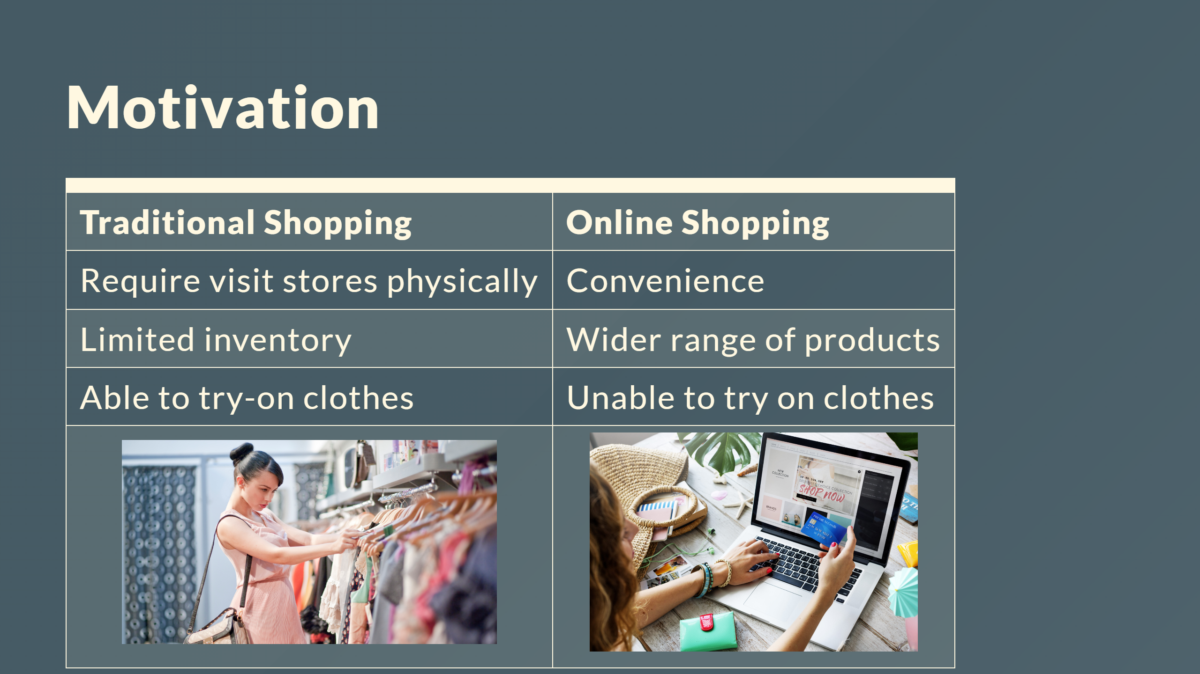

Slide 5
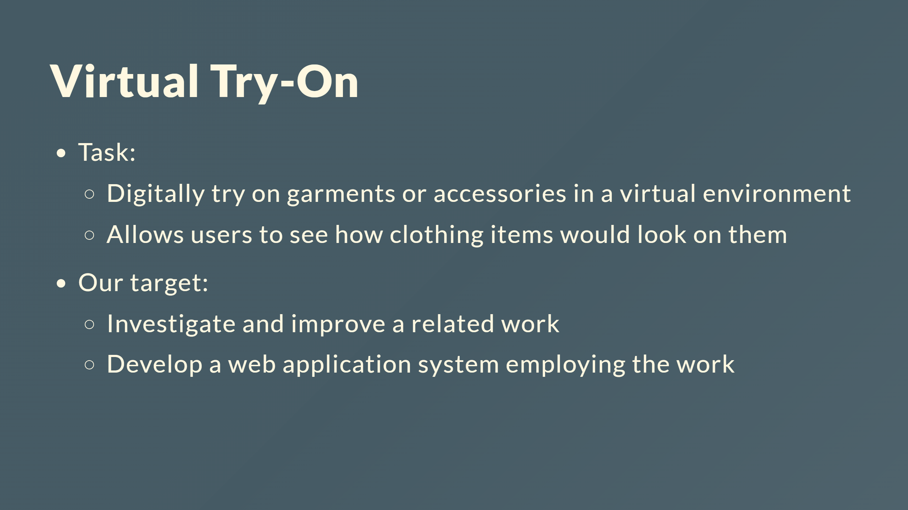

Slide 6
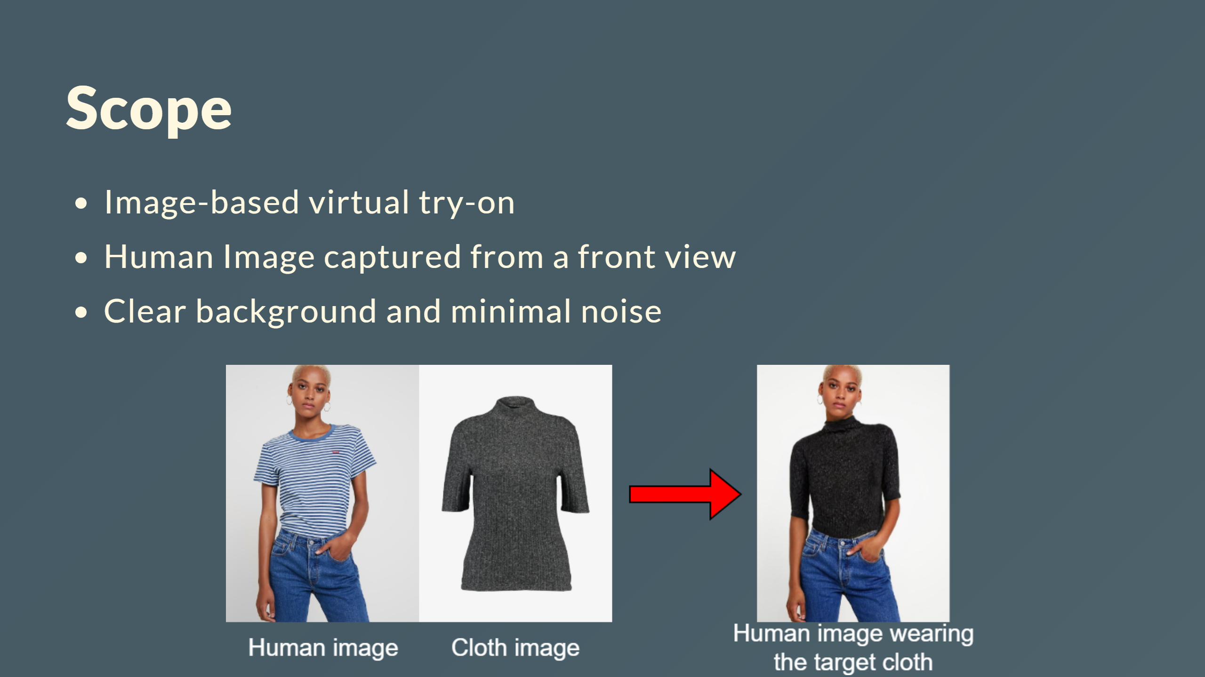

Slide 7


Slide 8
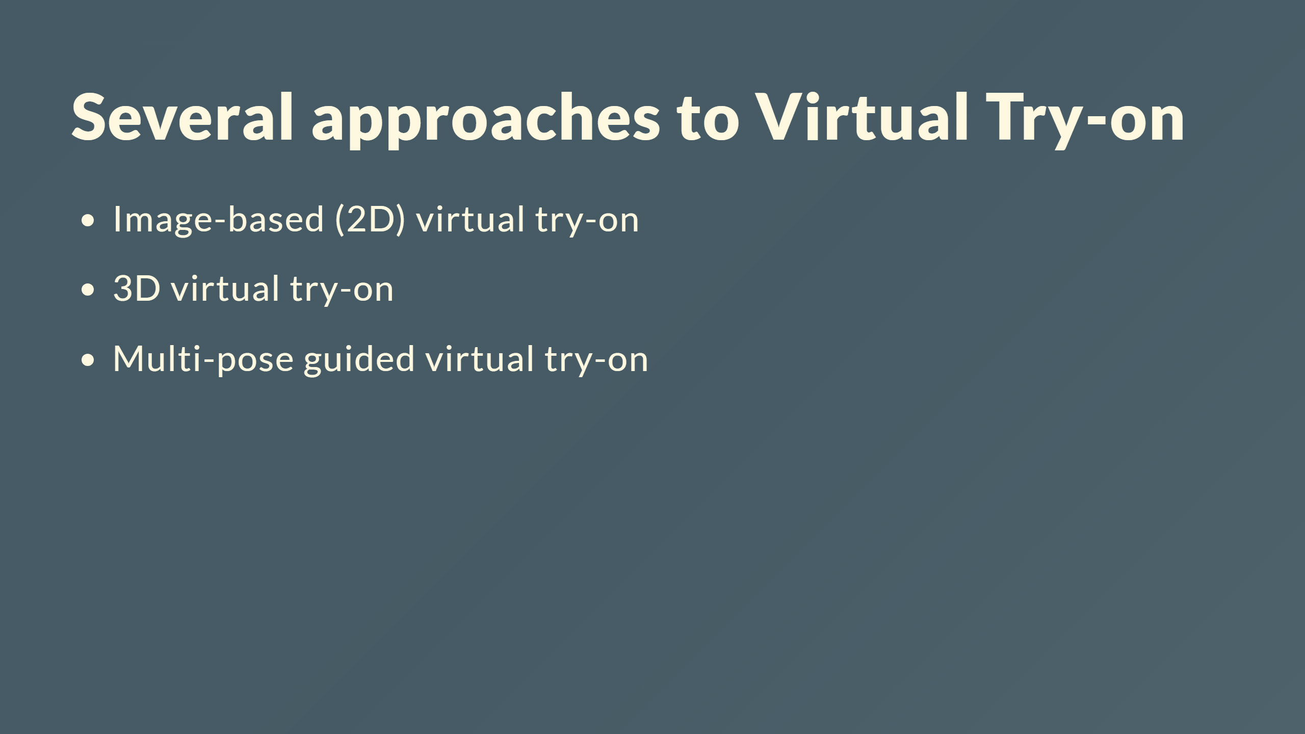
Notes:
- Virtual try-on with diffusion models

Slide 9
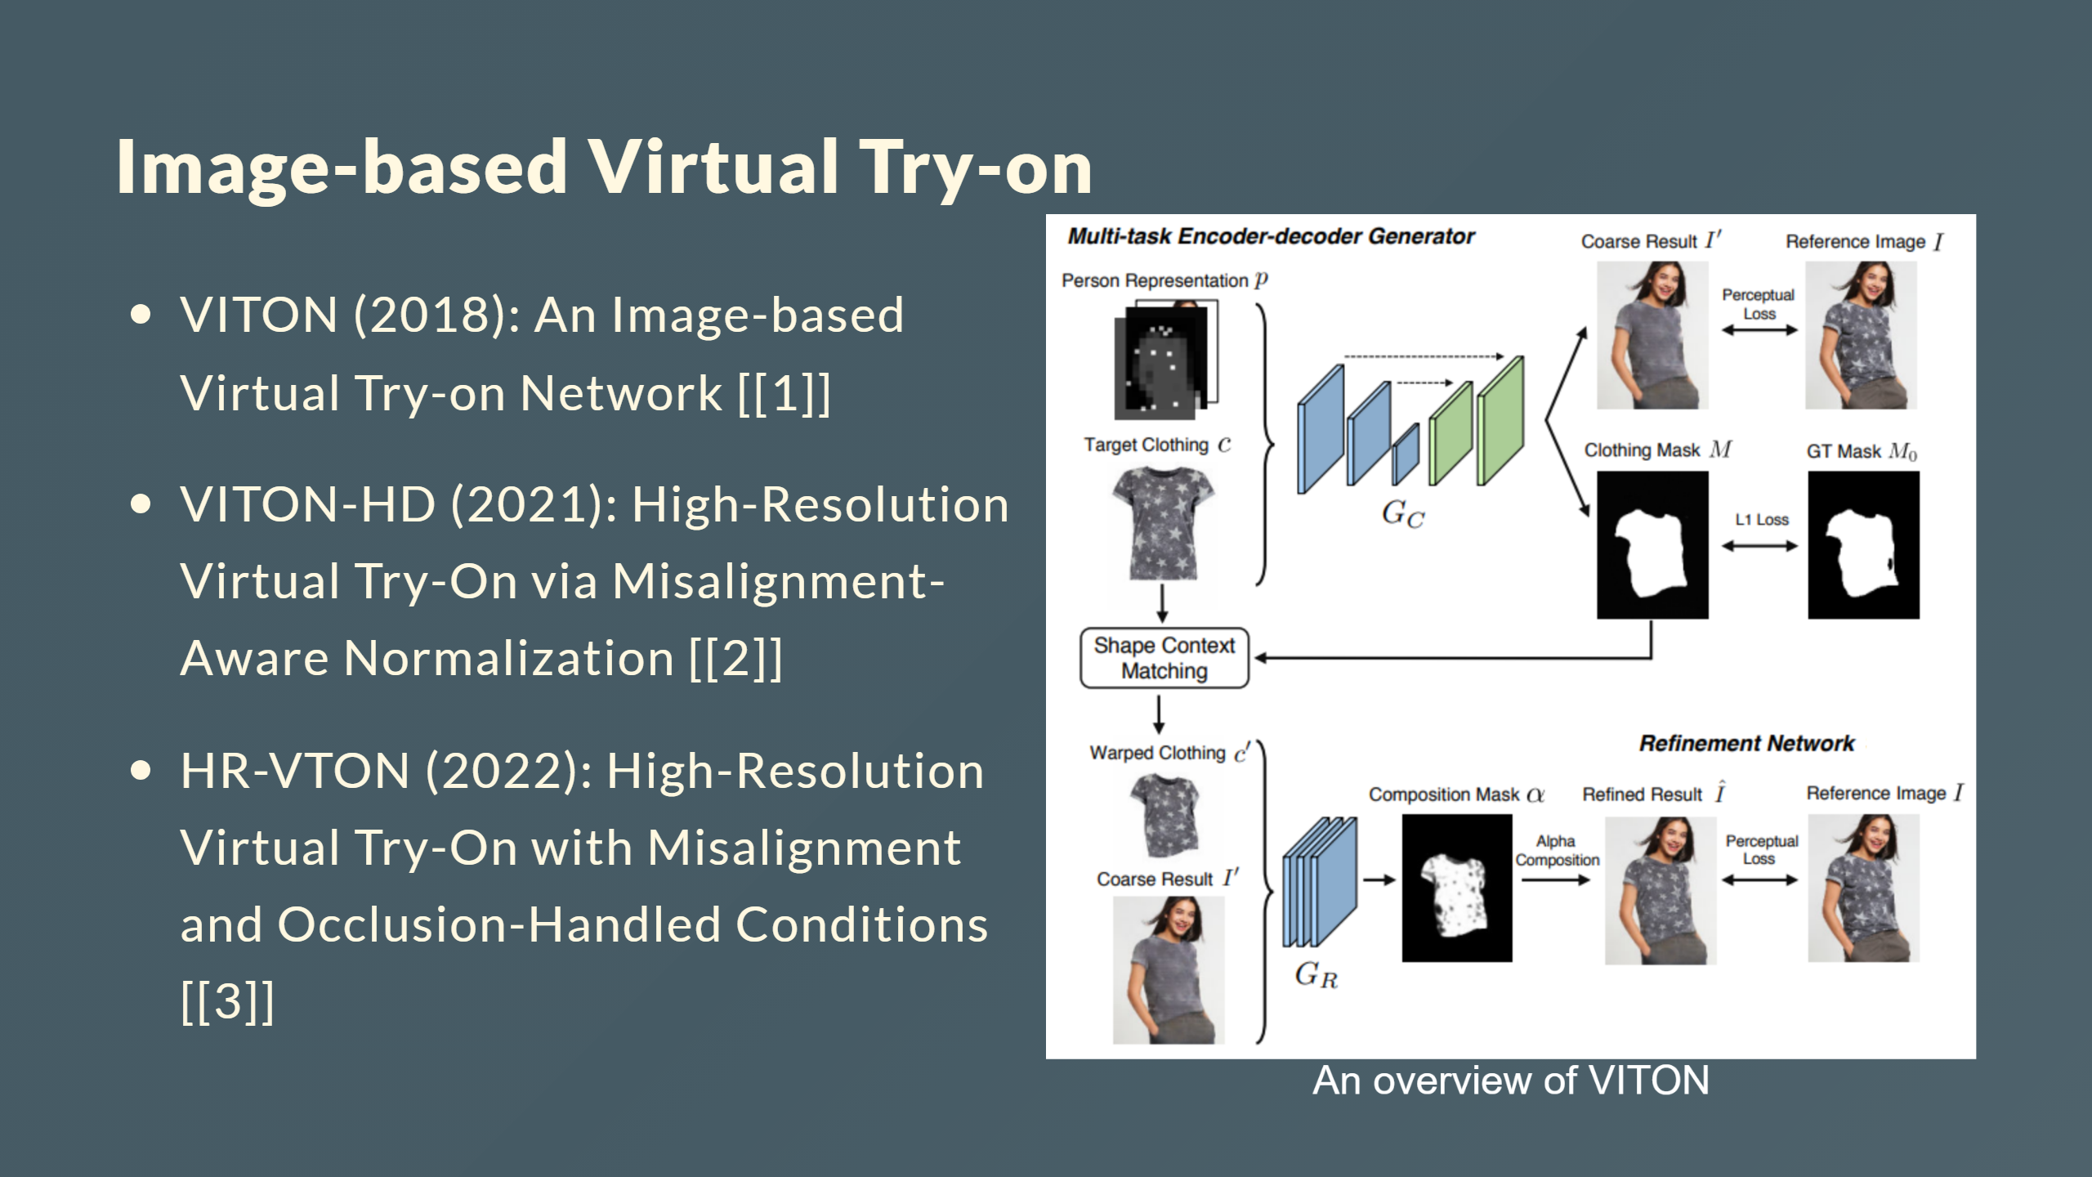

Slide 10
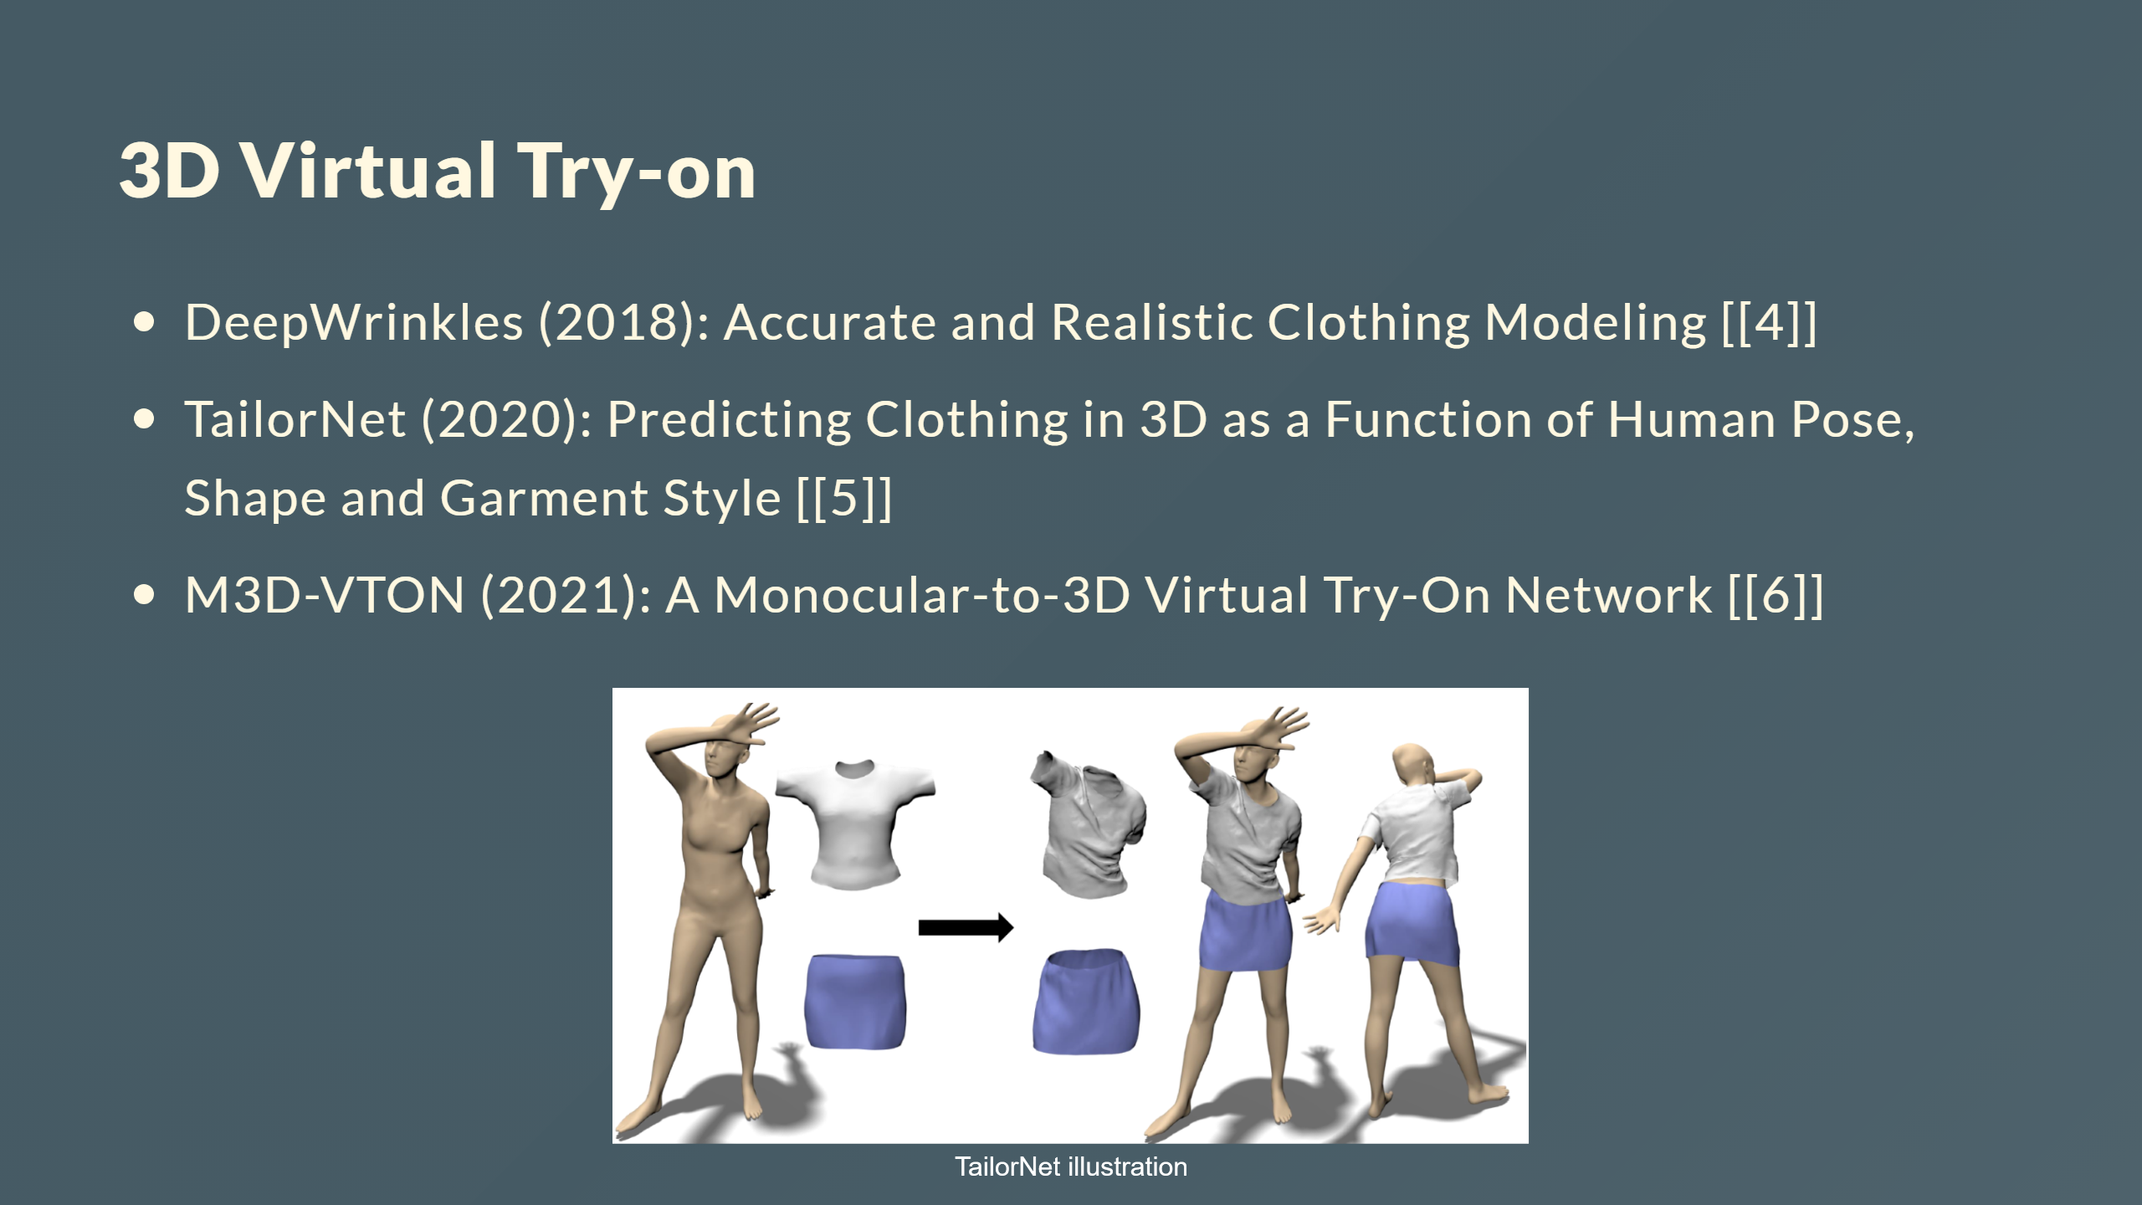

Slide 11
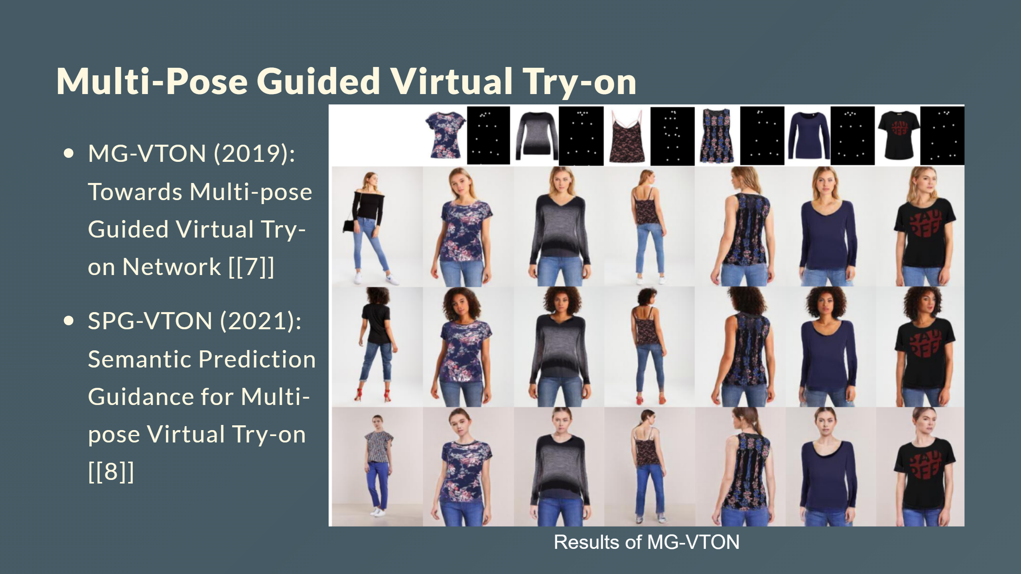
Notes:
--- # Virtual Try-on with Diffusion Models - Uses diffusion models like DDPM instead of GANs - Provides more control over quality and diversity - More stable training process - Notable works: TryOnDiffusion, LaDI-VTON

Slide 12
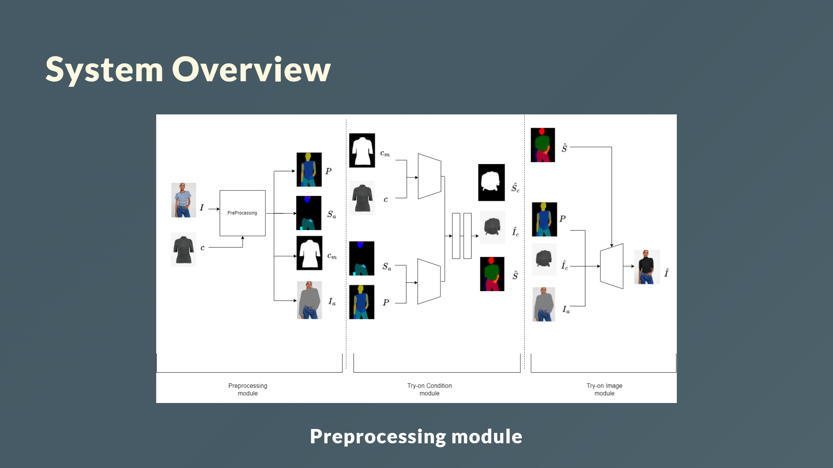

Slide 13
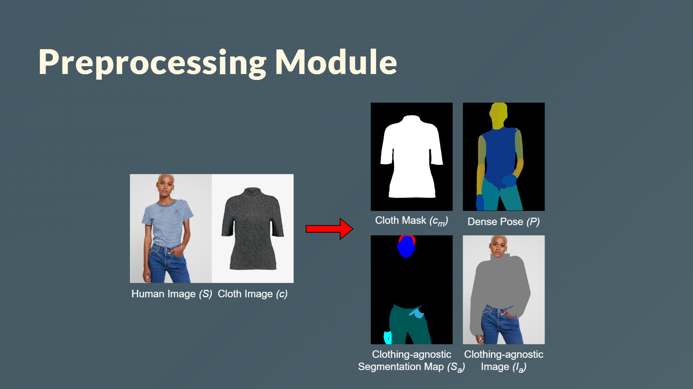

Slide 14
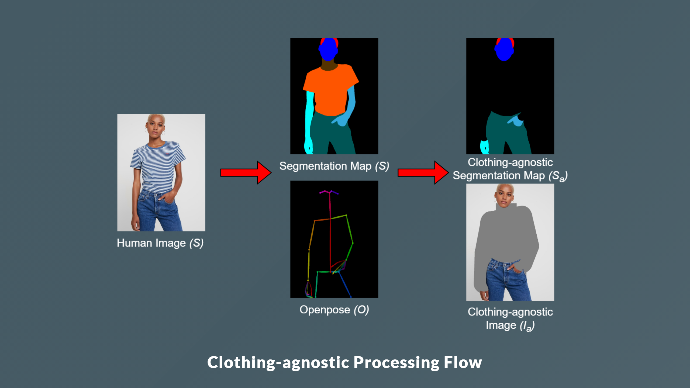

Slide 15
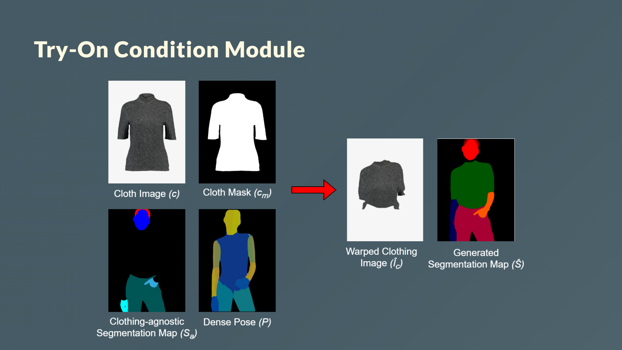

Slide 16
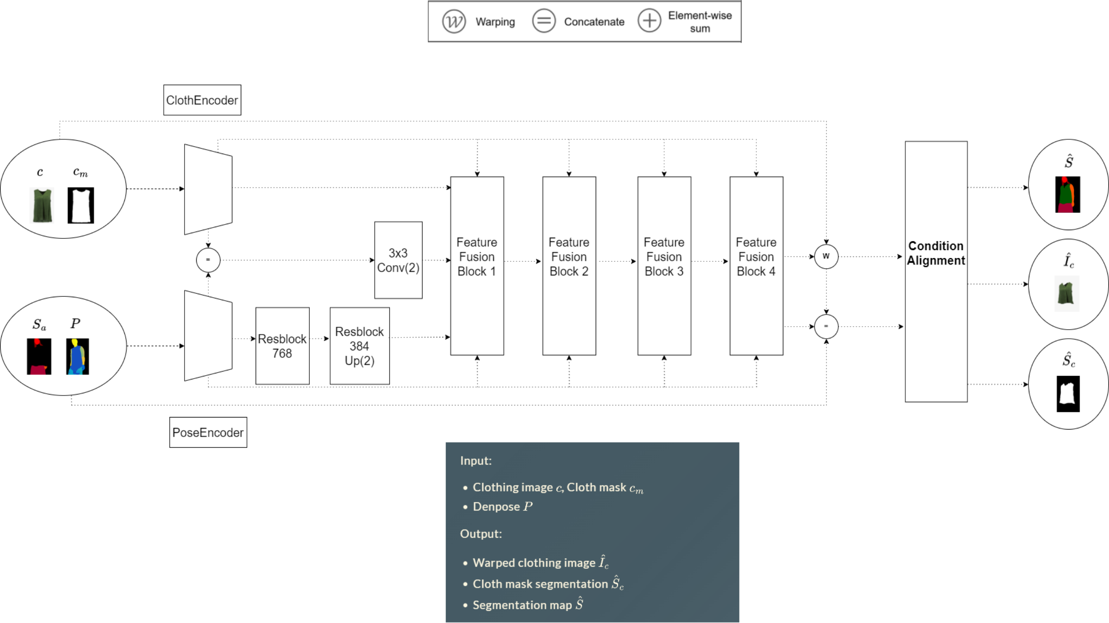
Notes:
</div>

Slide 17
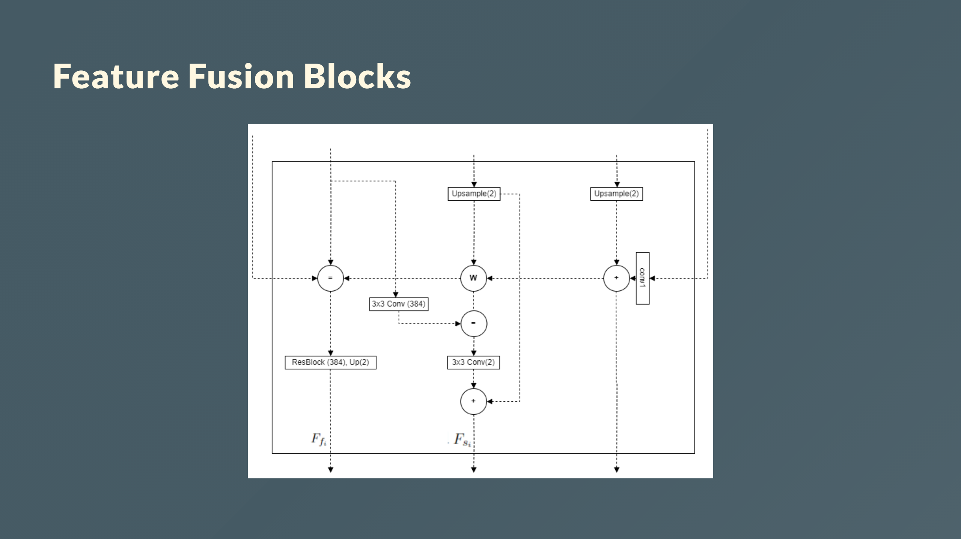
Notes:
- Has two routes: the flow pathway and the seg pathway. - Takes two inputs, $F_{f_{i-1}}$ and $F_{s_{i-1}}$. - The two pathways communicate with each other to determine $F_{f_i}$ and $F_{s_i}$ simultaneously.

Slide 18
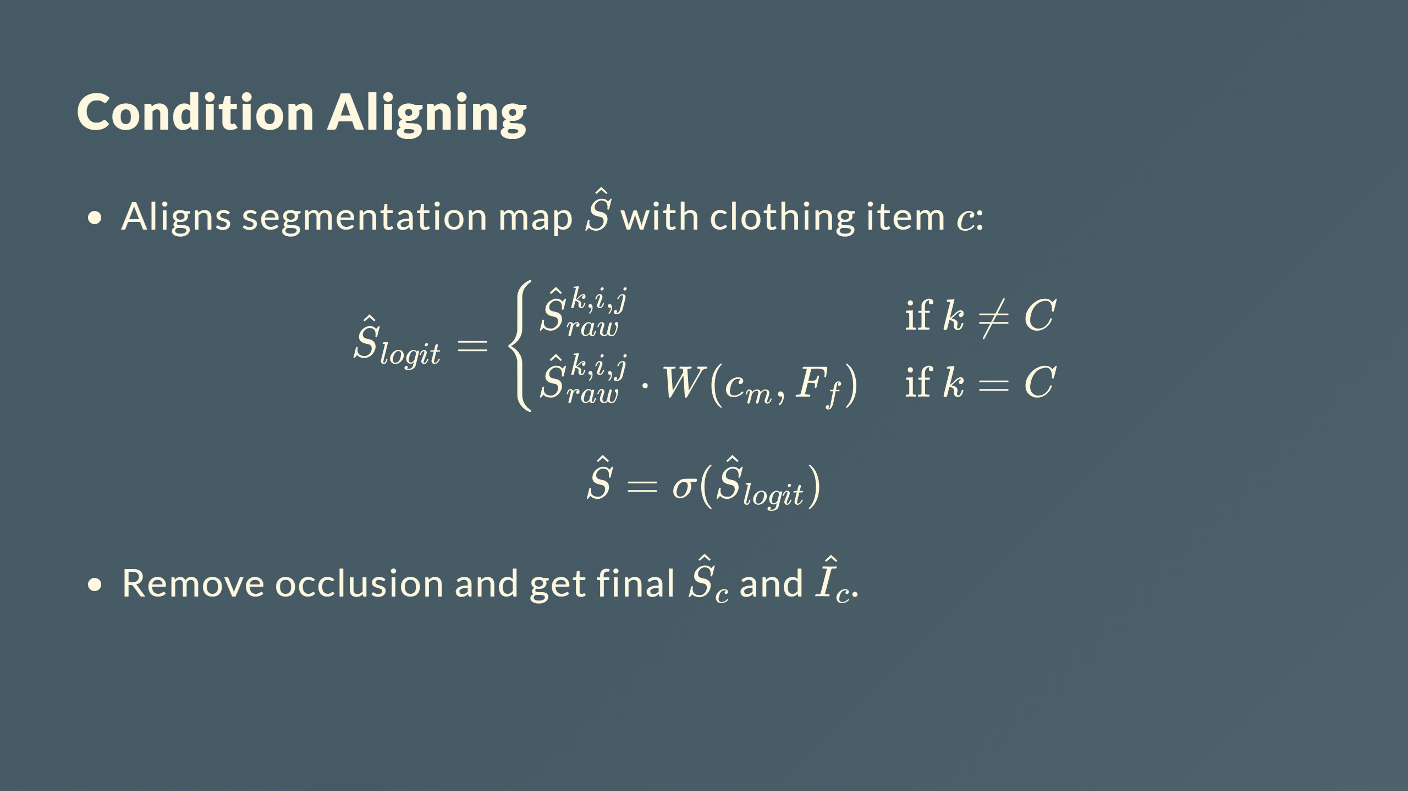

Slide 19
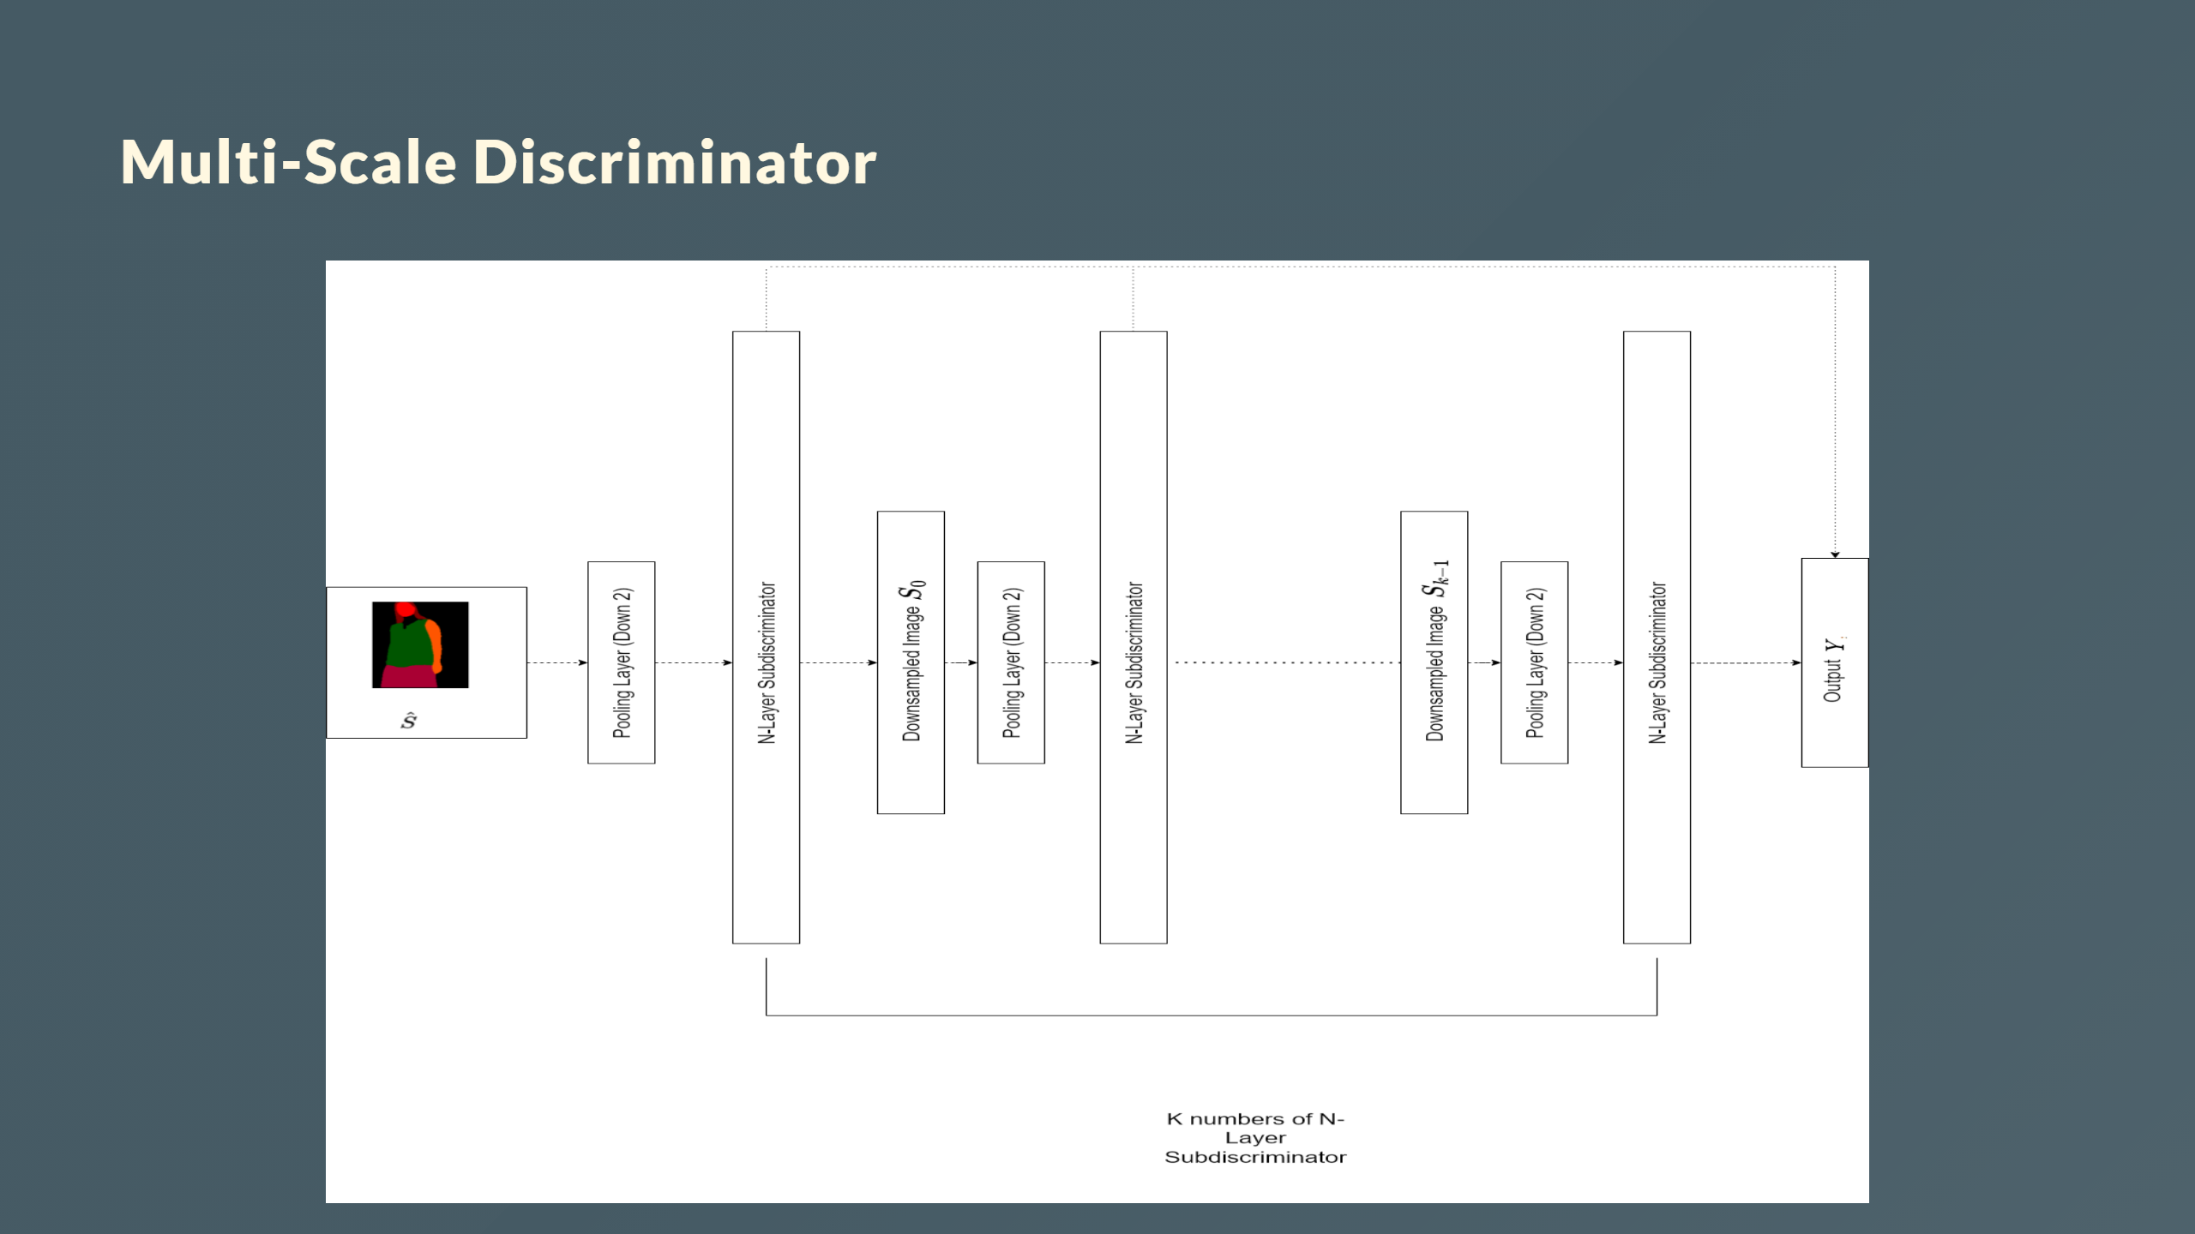
Notes:
- Each $D_i$ operates on downsampled $S_i$ - Concatenates $\hat{Y}_i$ outputs into final $Y$ - Captures multi-scale information - $k$ of $N$-layer sub-discriminators $D_i$ --- <div style="color: white; font-size: 30px; margin-top: 150px; margin-left:0px"> <b>Multi-Scale Discriminator</b> - Each $D_i$ operates on downsampled $S_i$ - Concatenates $\hat{Y}_i$ outputs into final $Y$ - Captures multi-scale information - $k$ of $N$-layer sub-discriminators $D_i$ </div>

Slide 20
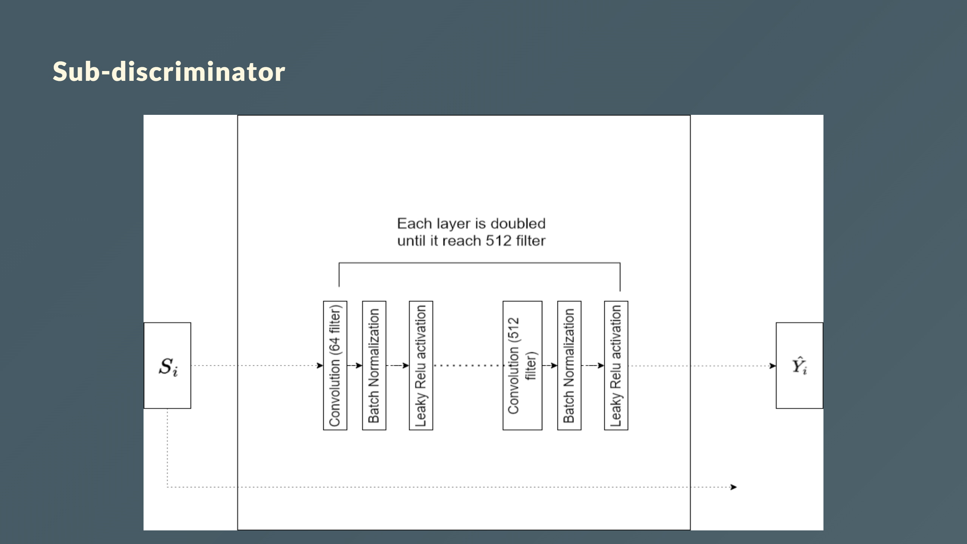
Notes:
- Input: Downsampled segmentation map $S_i$ - Output: Prediction map $\hat{Y}_i$ - Consits of $N$ convolutional layers --- <div style="color: white; font-size: 30px; margin-top: 150px; margin-left:0px"> <b>Sub-discriminator </b> - Input: Downsampled segmentation map $S_i$ - Output: Prediction map $\hat{Y}_i$ - Consits of $N$ convolutional layers </div>

Slide 21
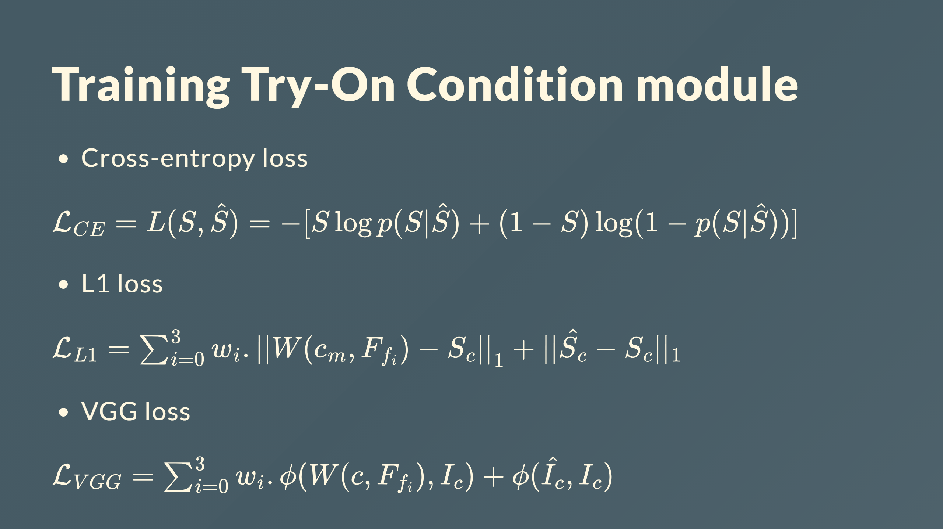

Slide 22
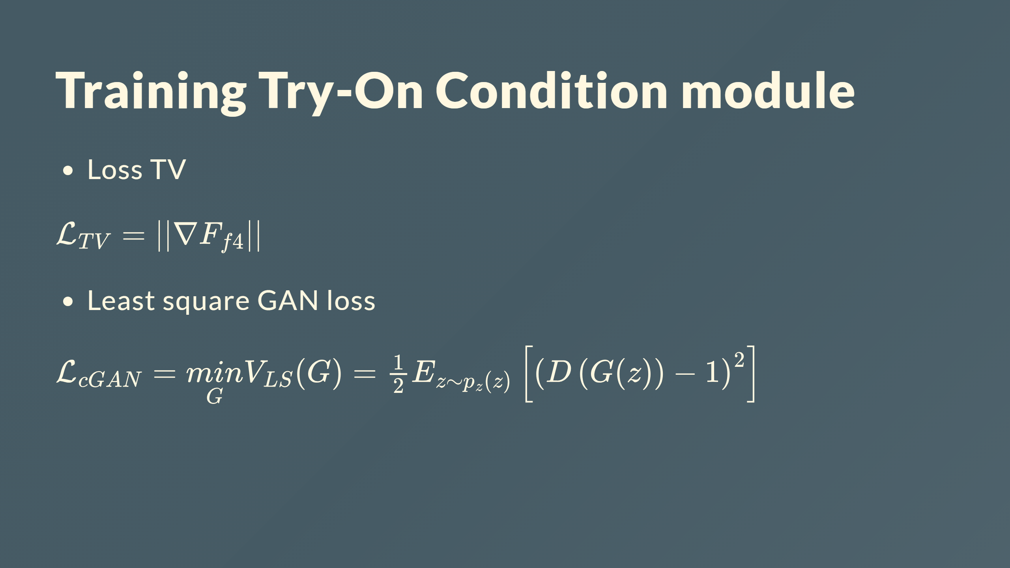

Slide 23
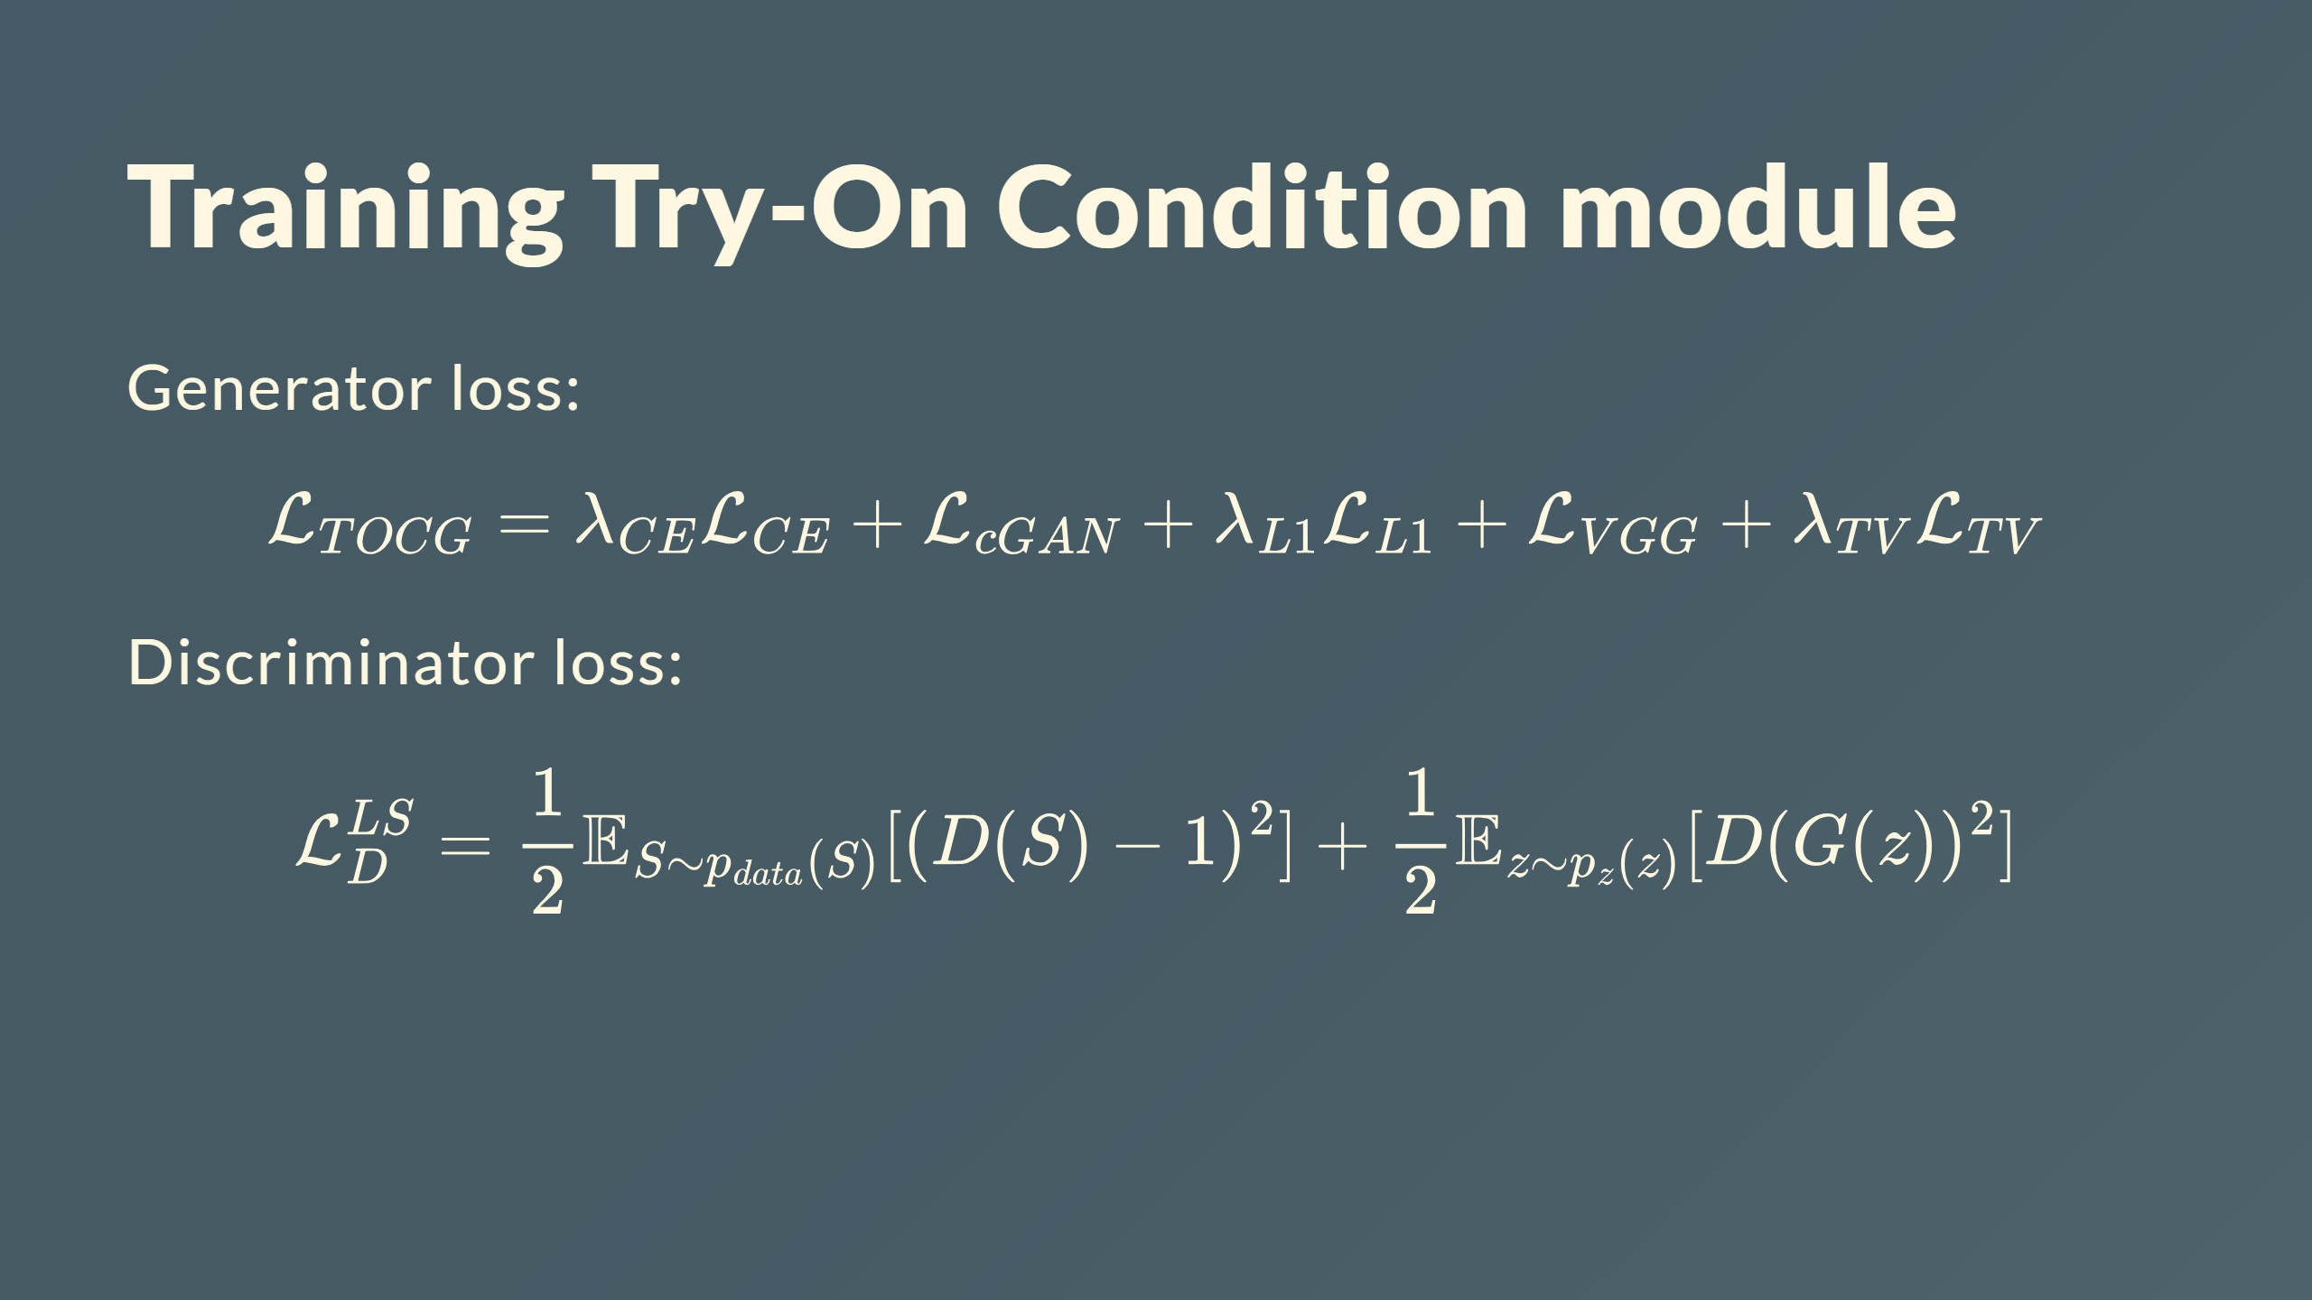

Slide 24
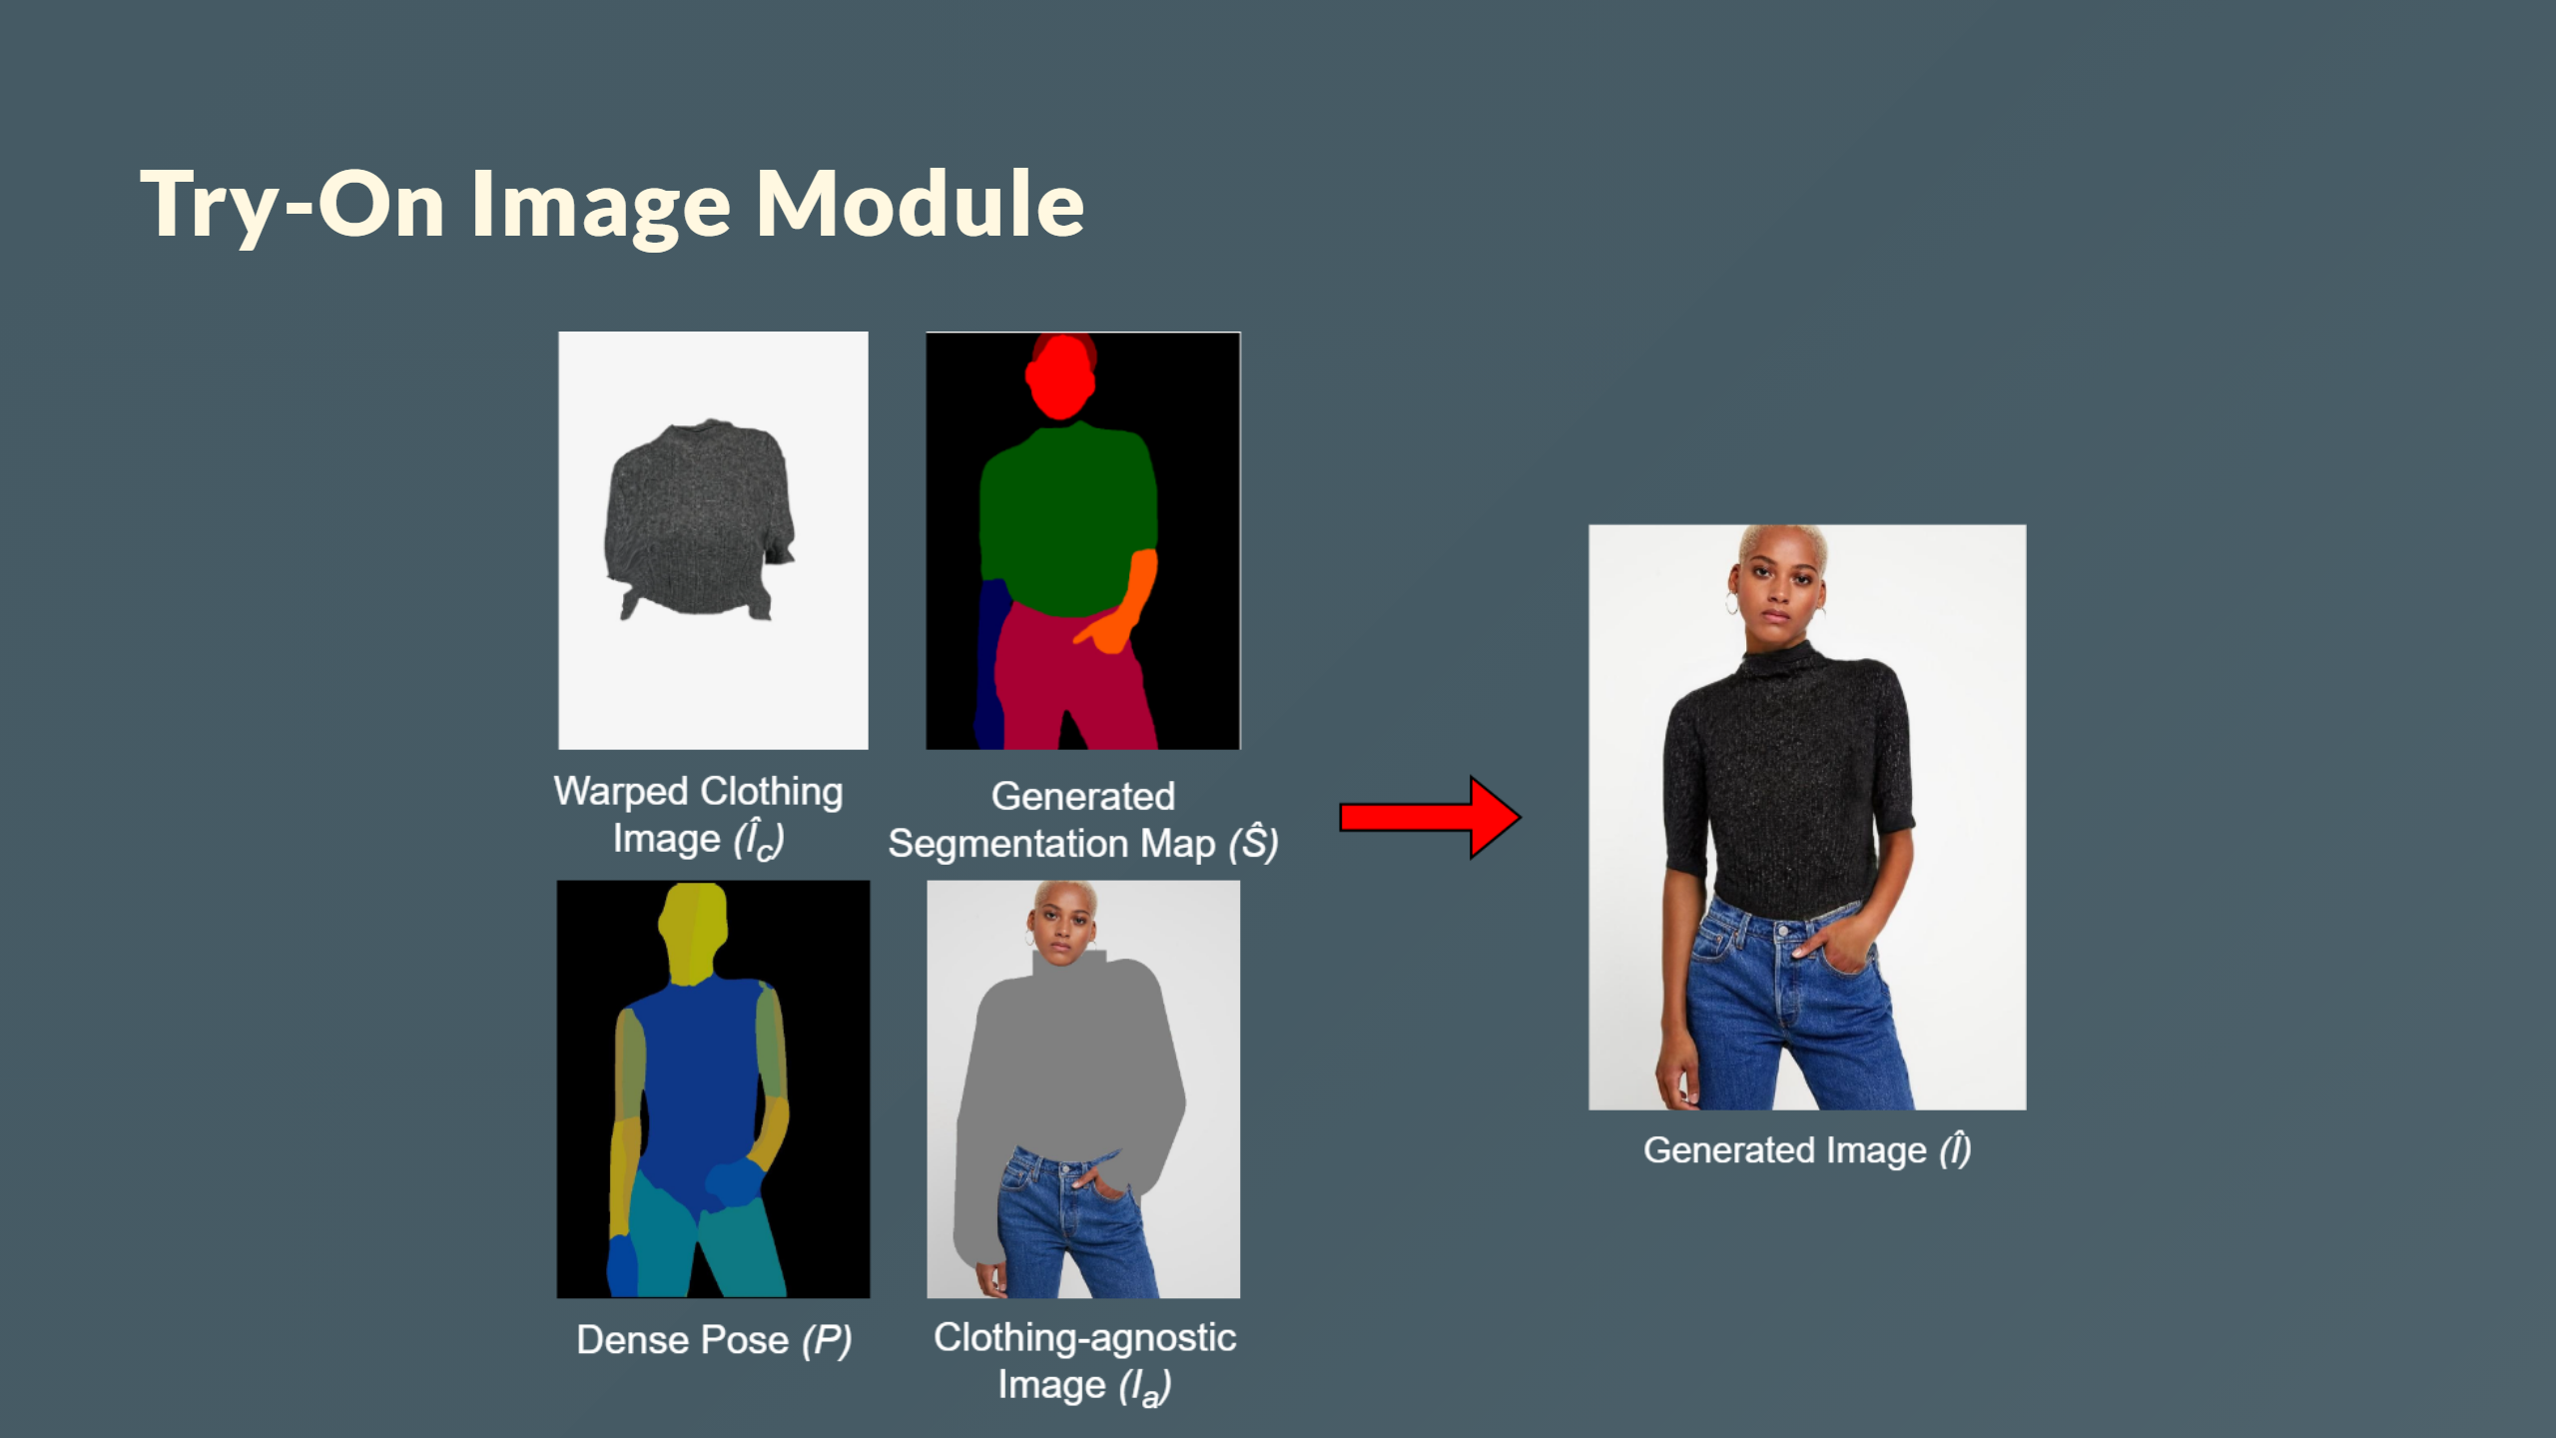

Slide 25
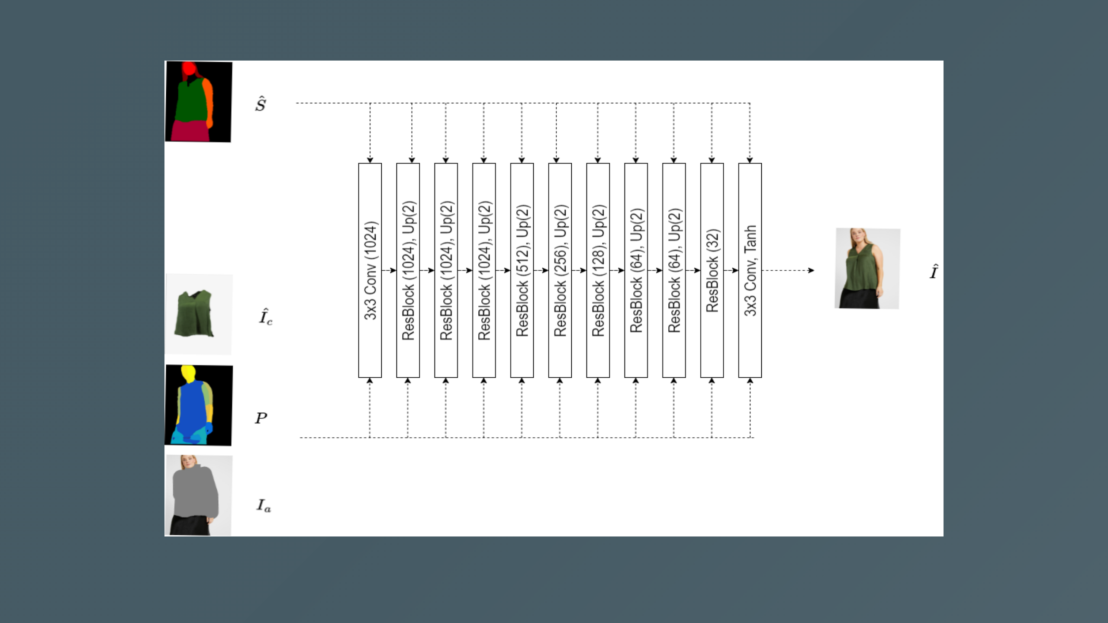

Slide 26
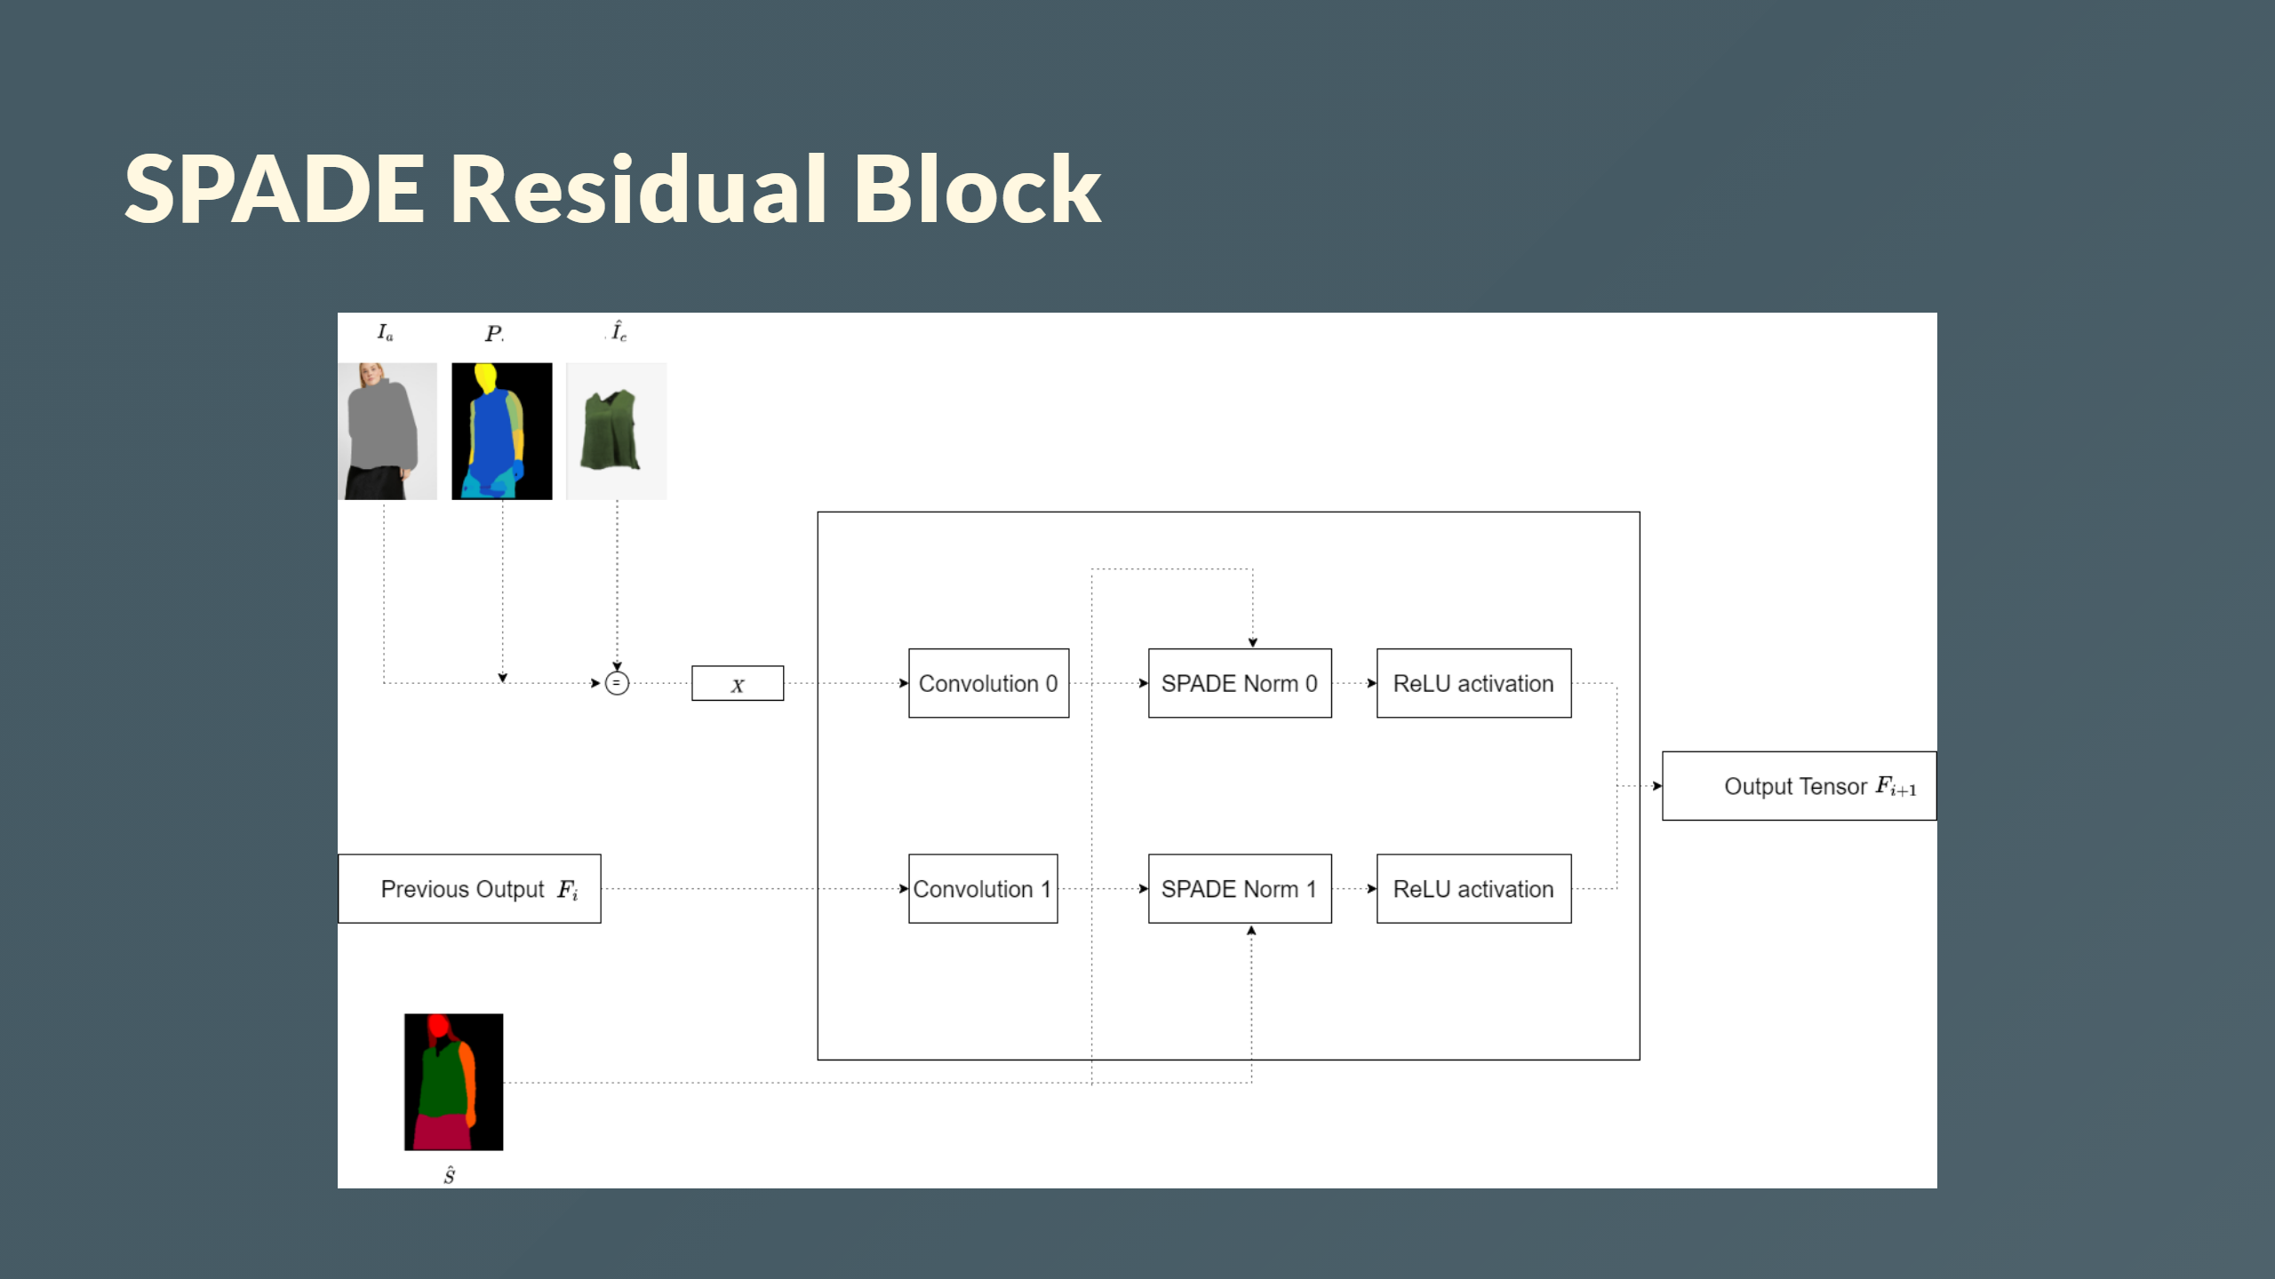
Notes:
<div style="color: white; font-size: 30px; margin-top: 30px; text-align: center; "> <b>Spade Residual Block</b> </div>

Slide 27
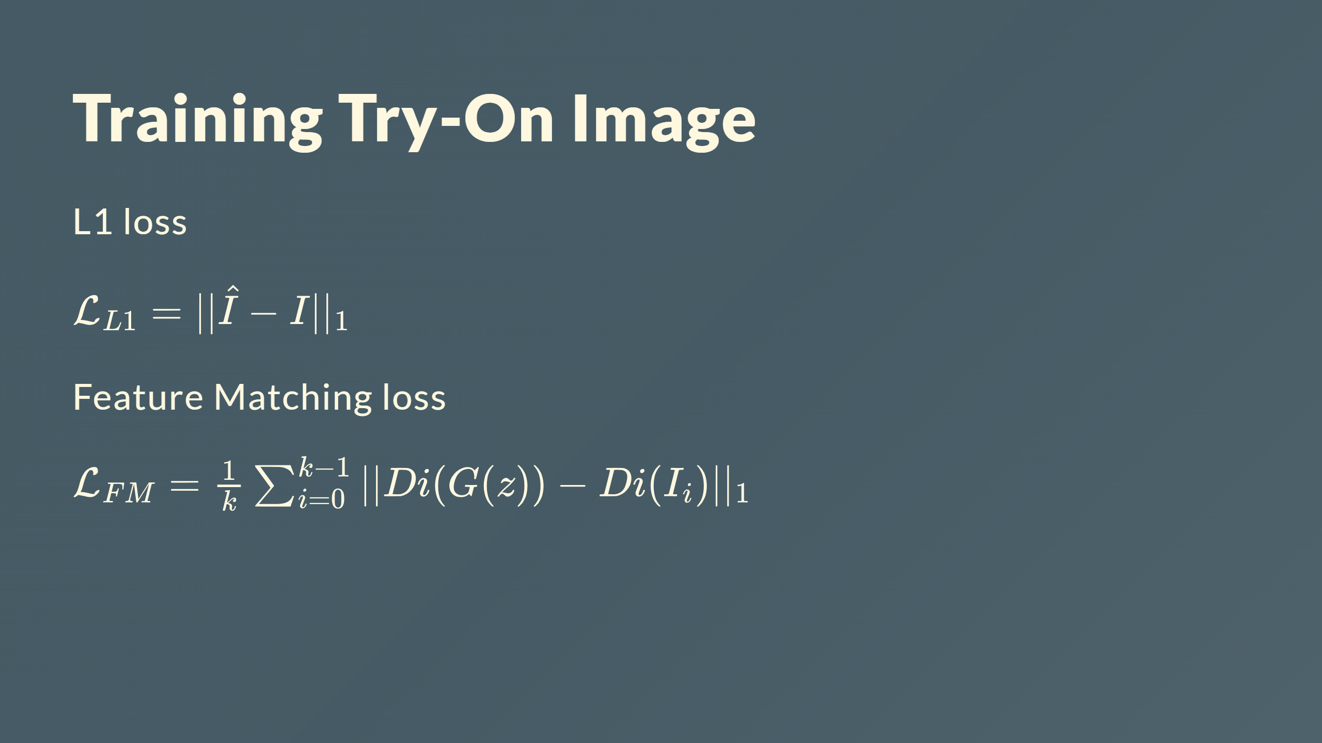

Slide 28
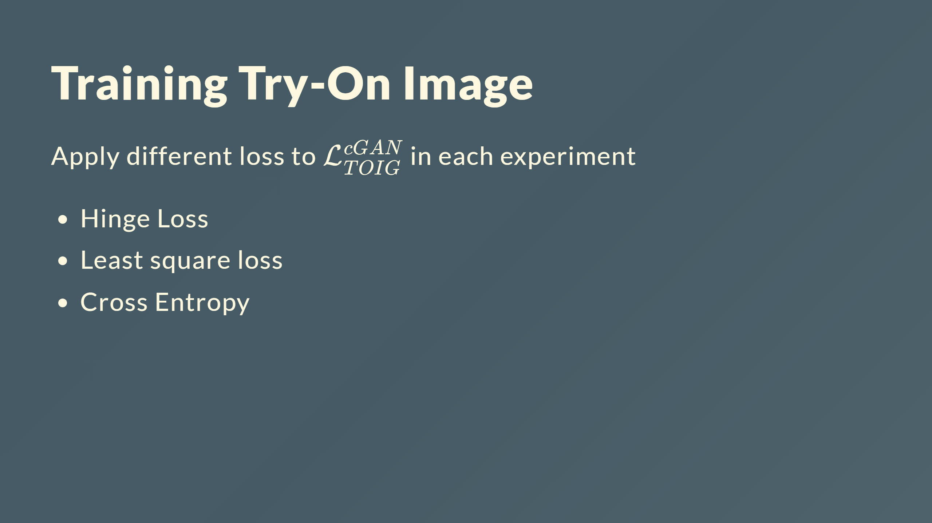

Slide 29
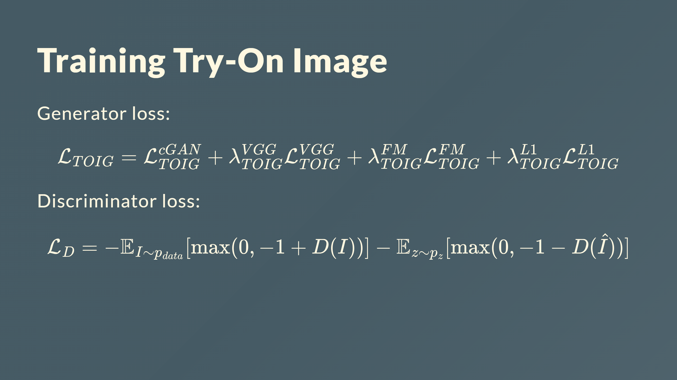

Slide 30
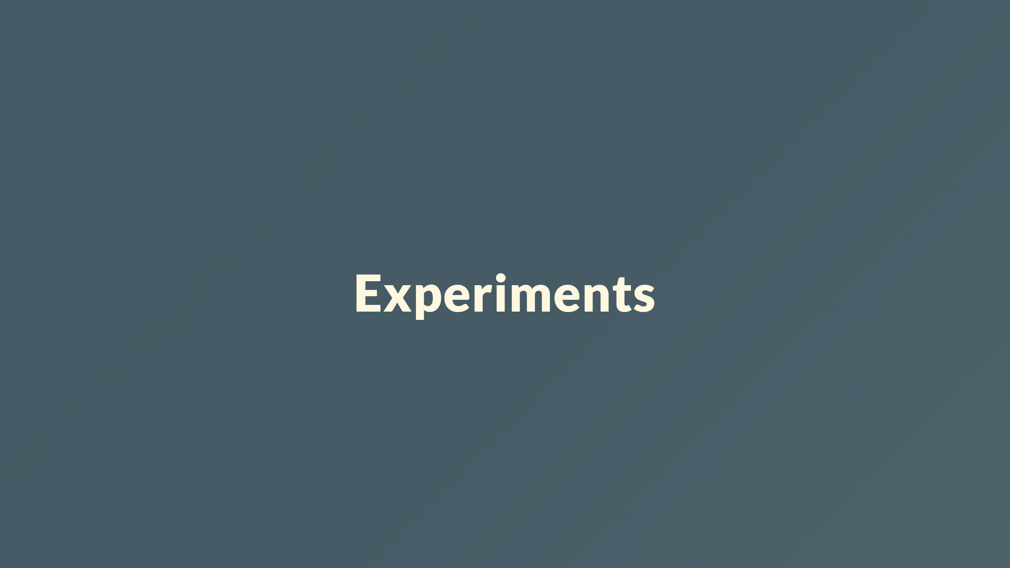

Slide 31
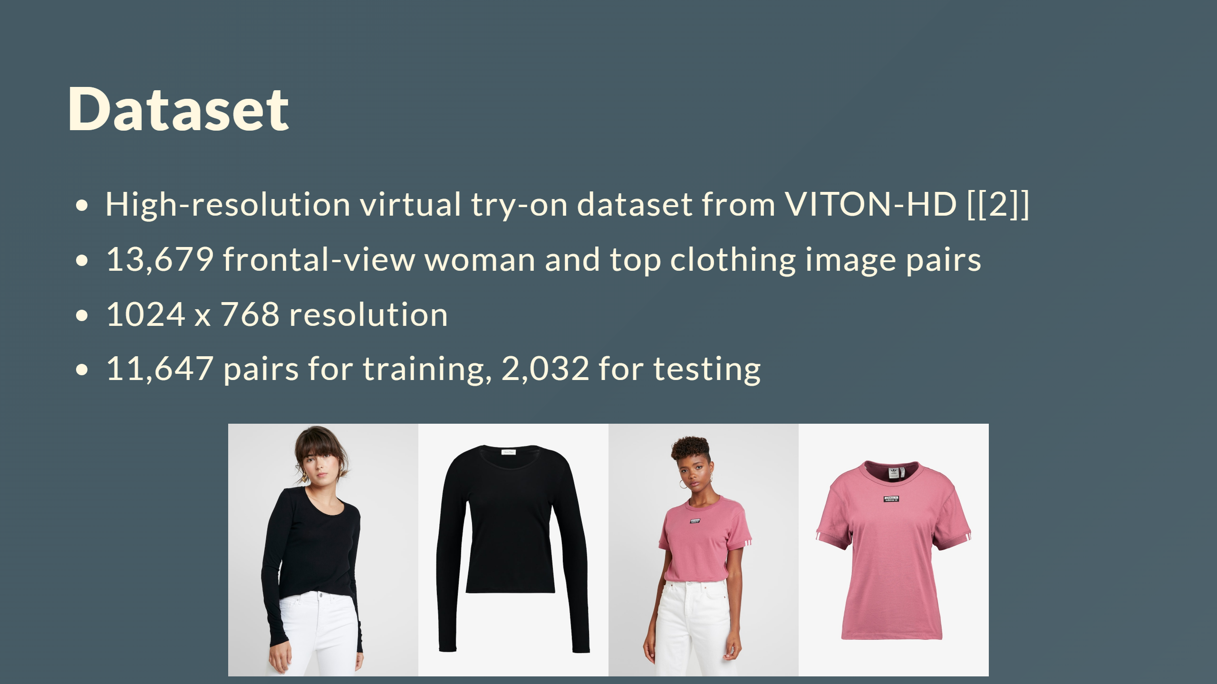

Slide 32
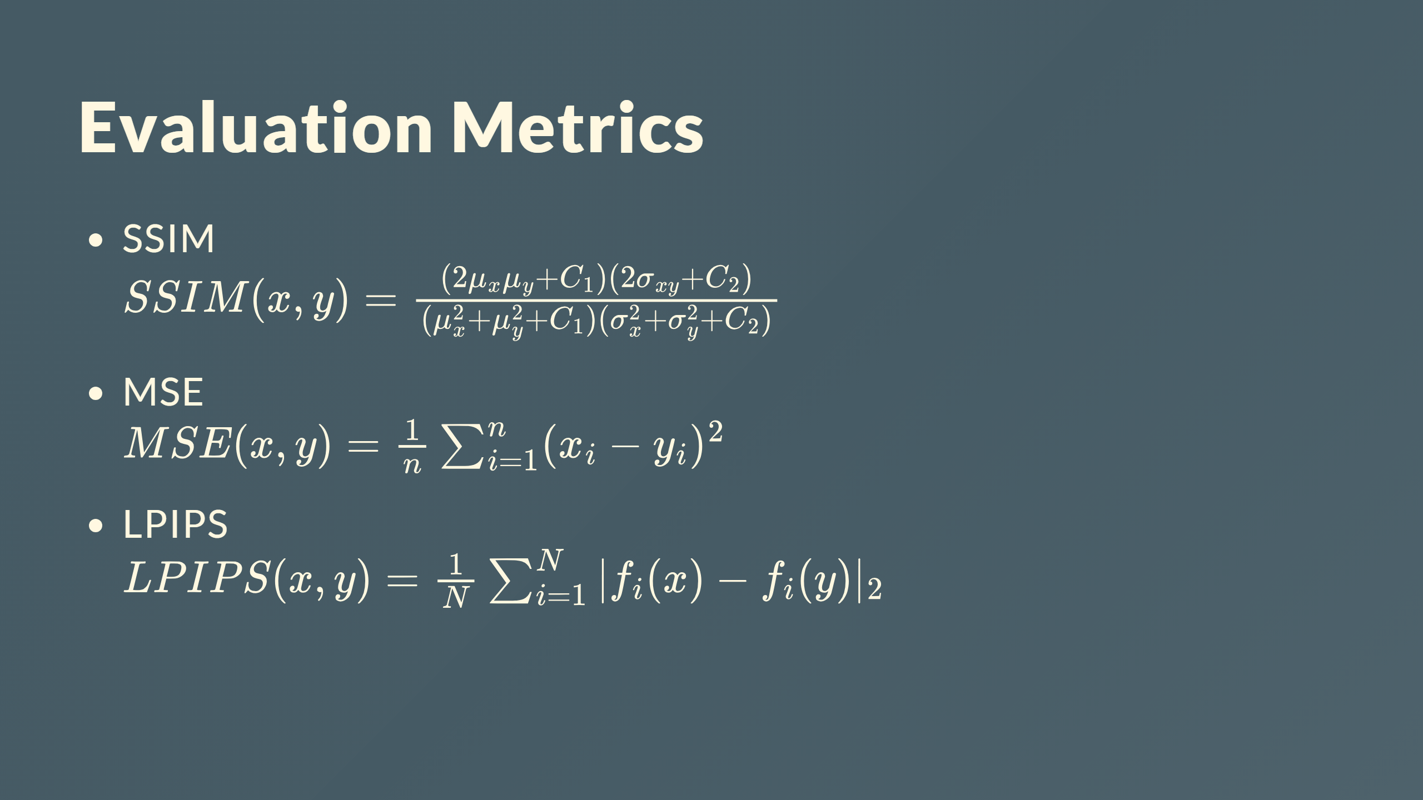

Slide 33
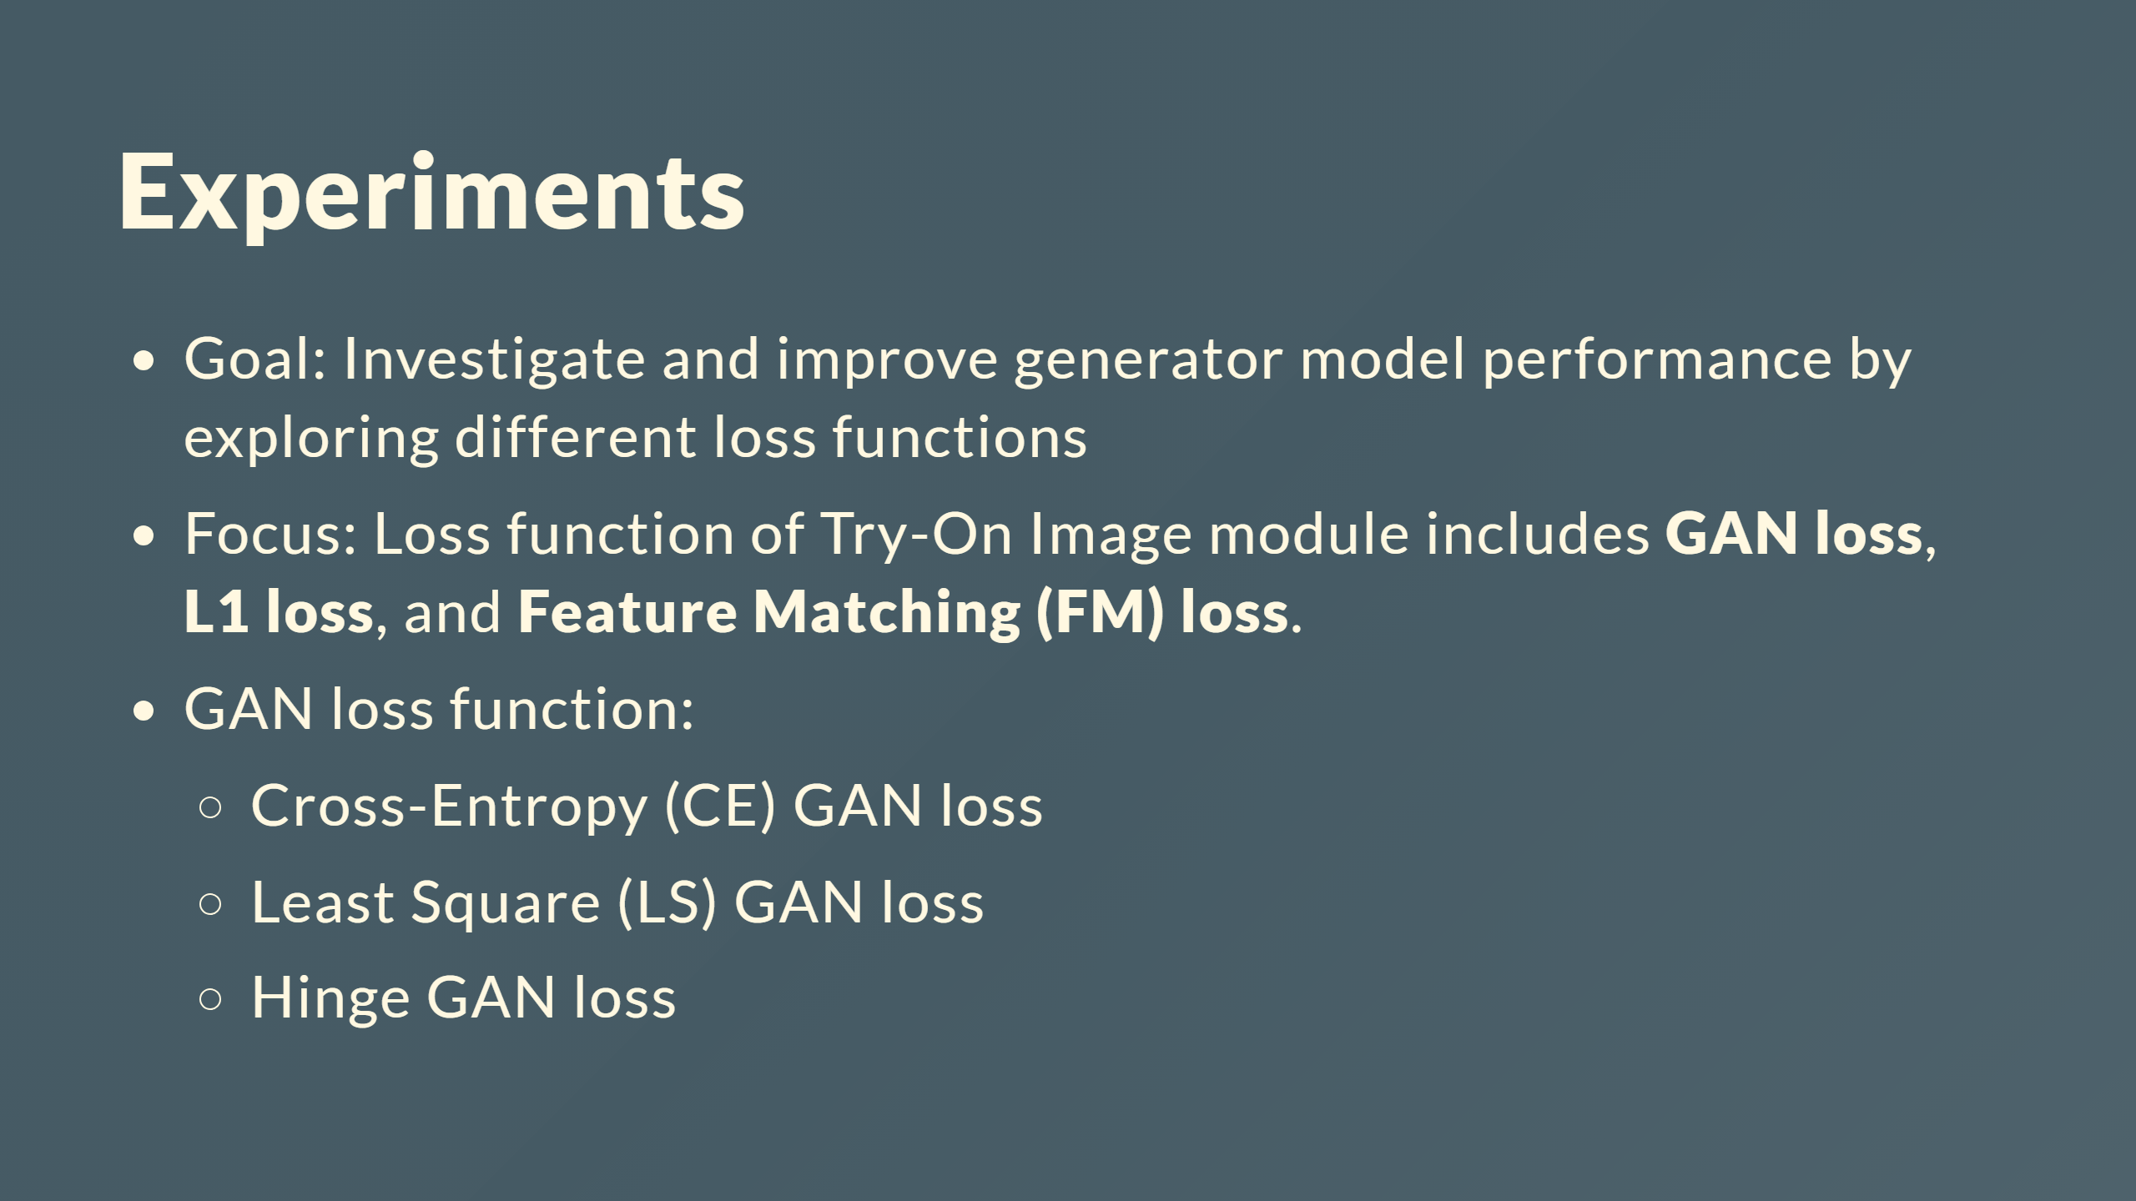

Slide 34
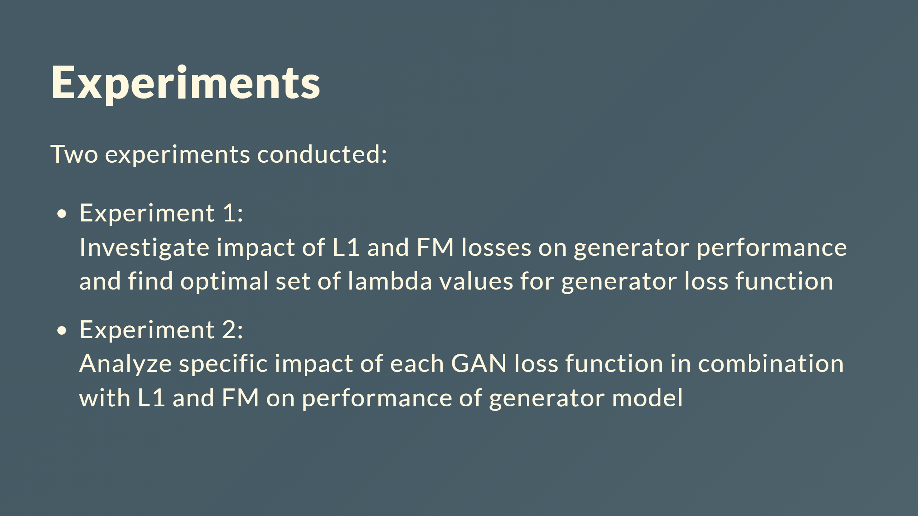

Slide 35
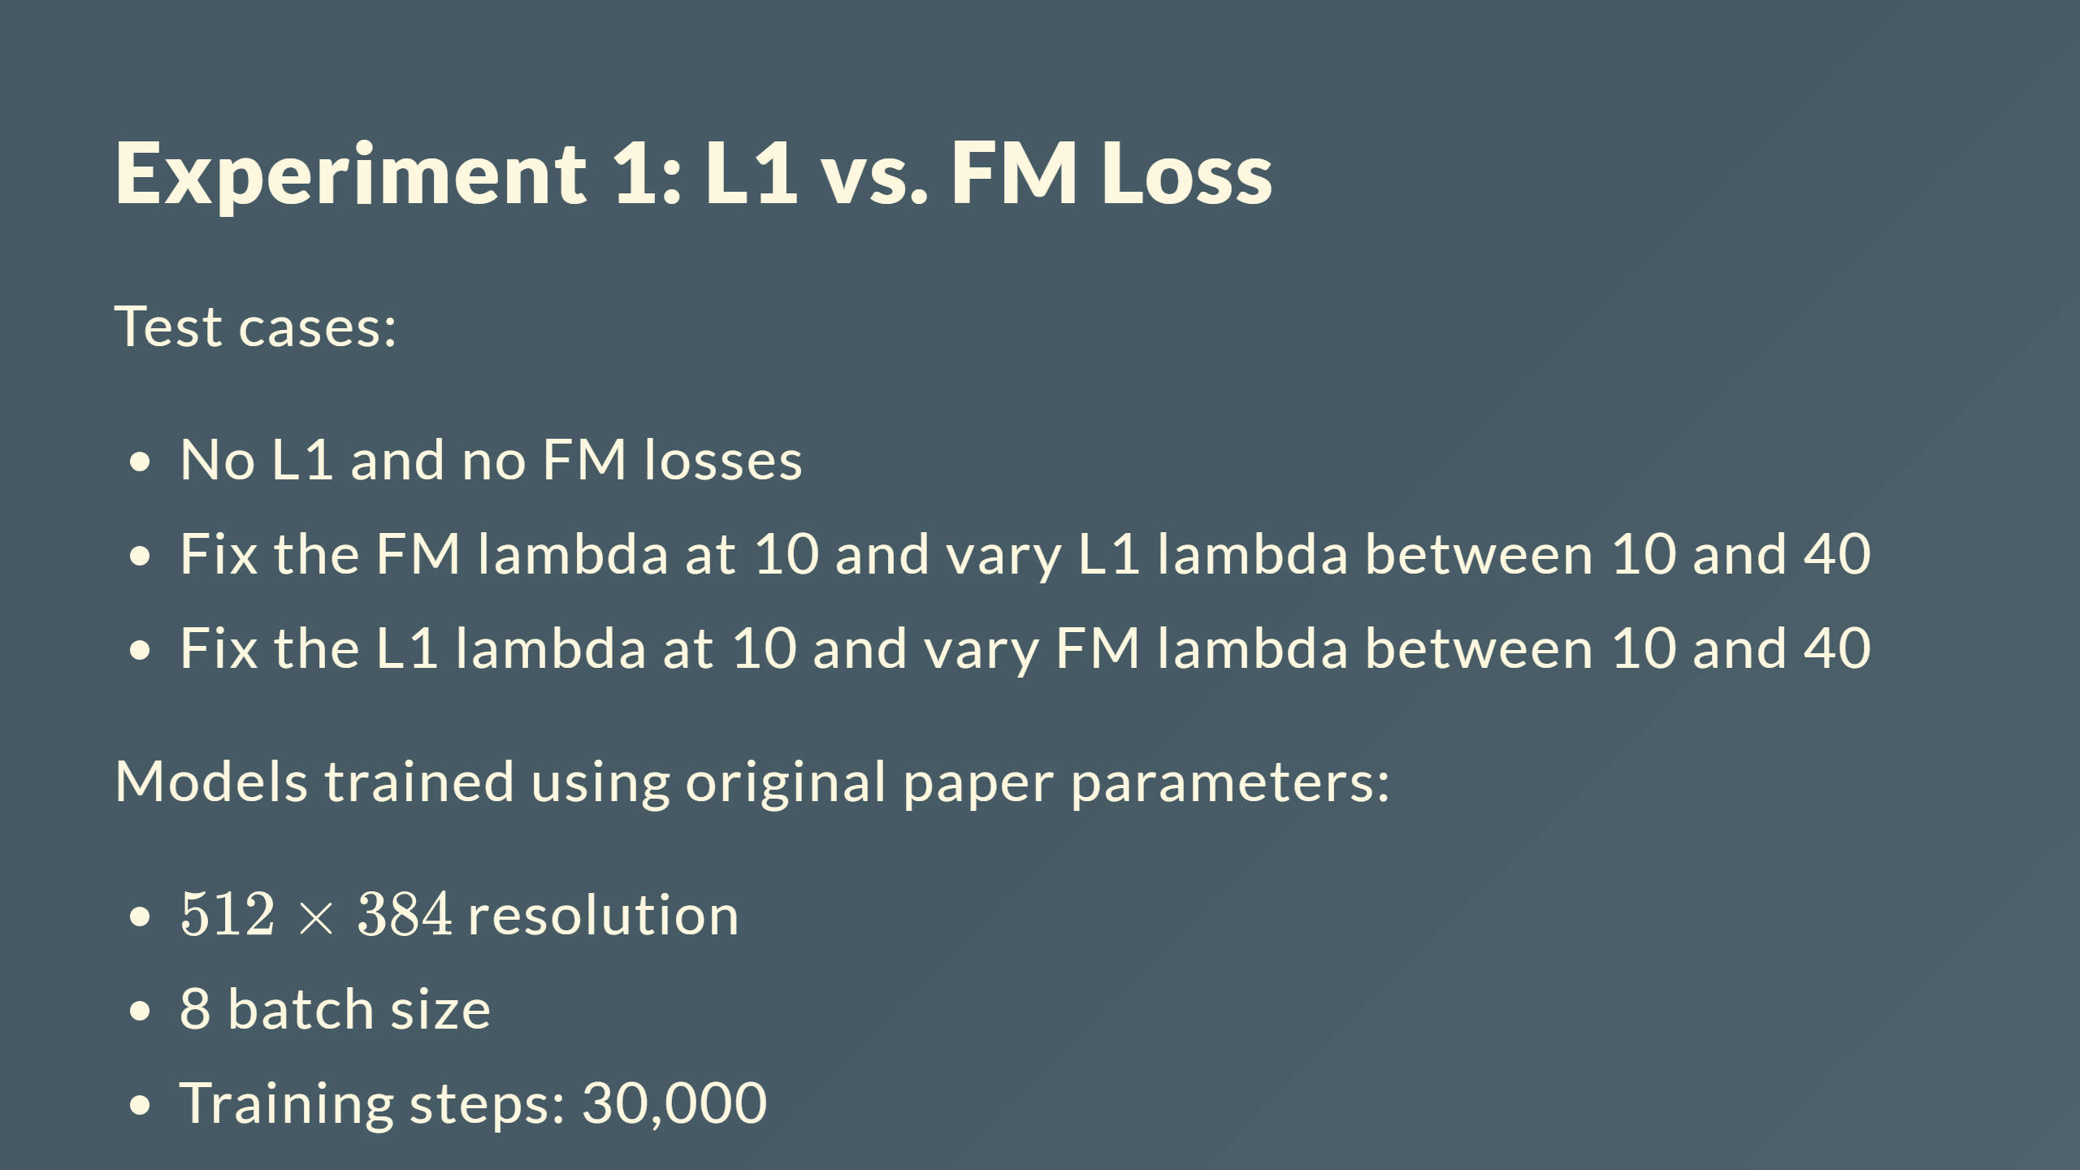
Notes:
<div style="text-align:center"><img src="Exp1-table.png" width="650" style="float:right;"></div>

Slide 36
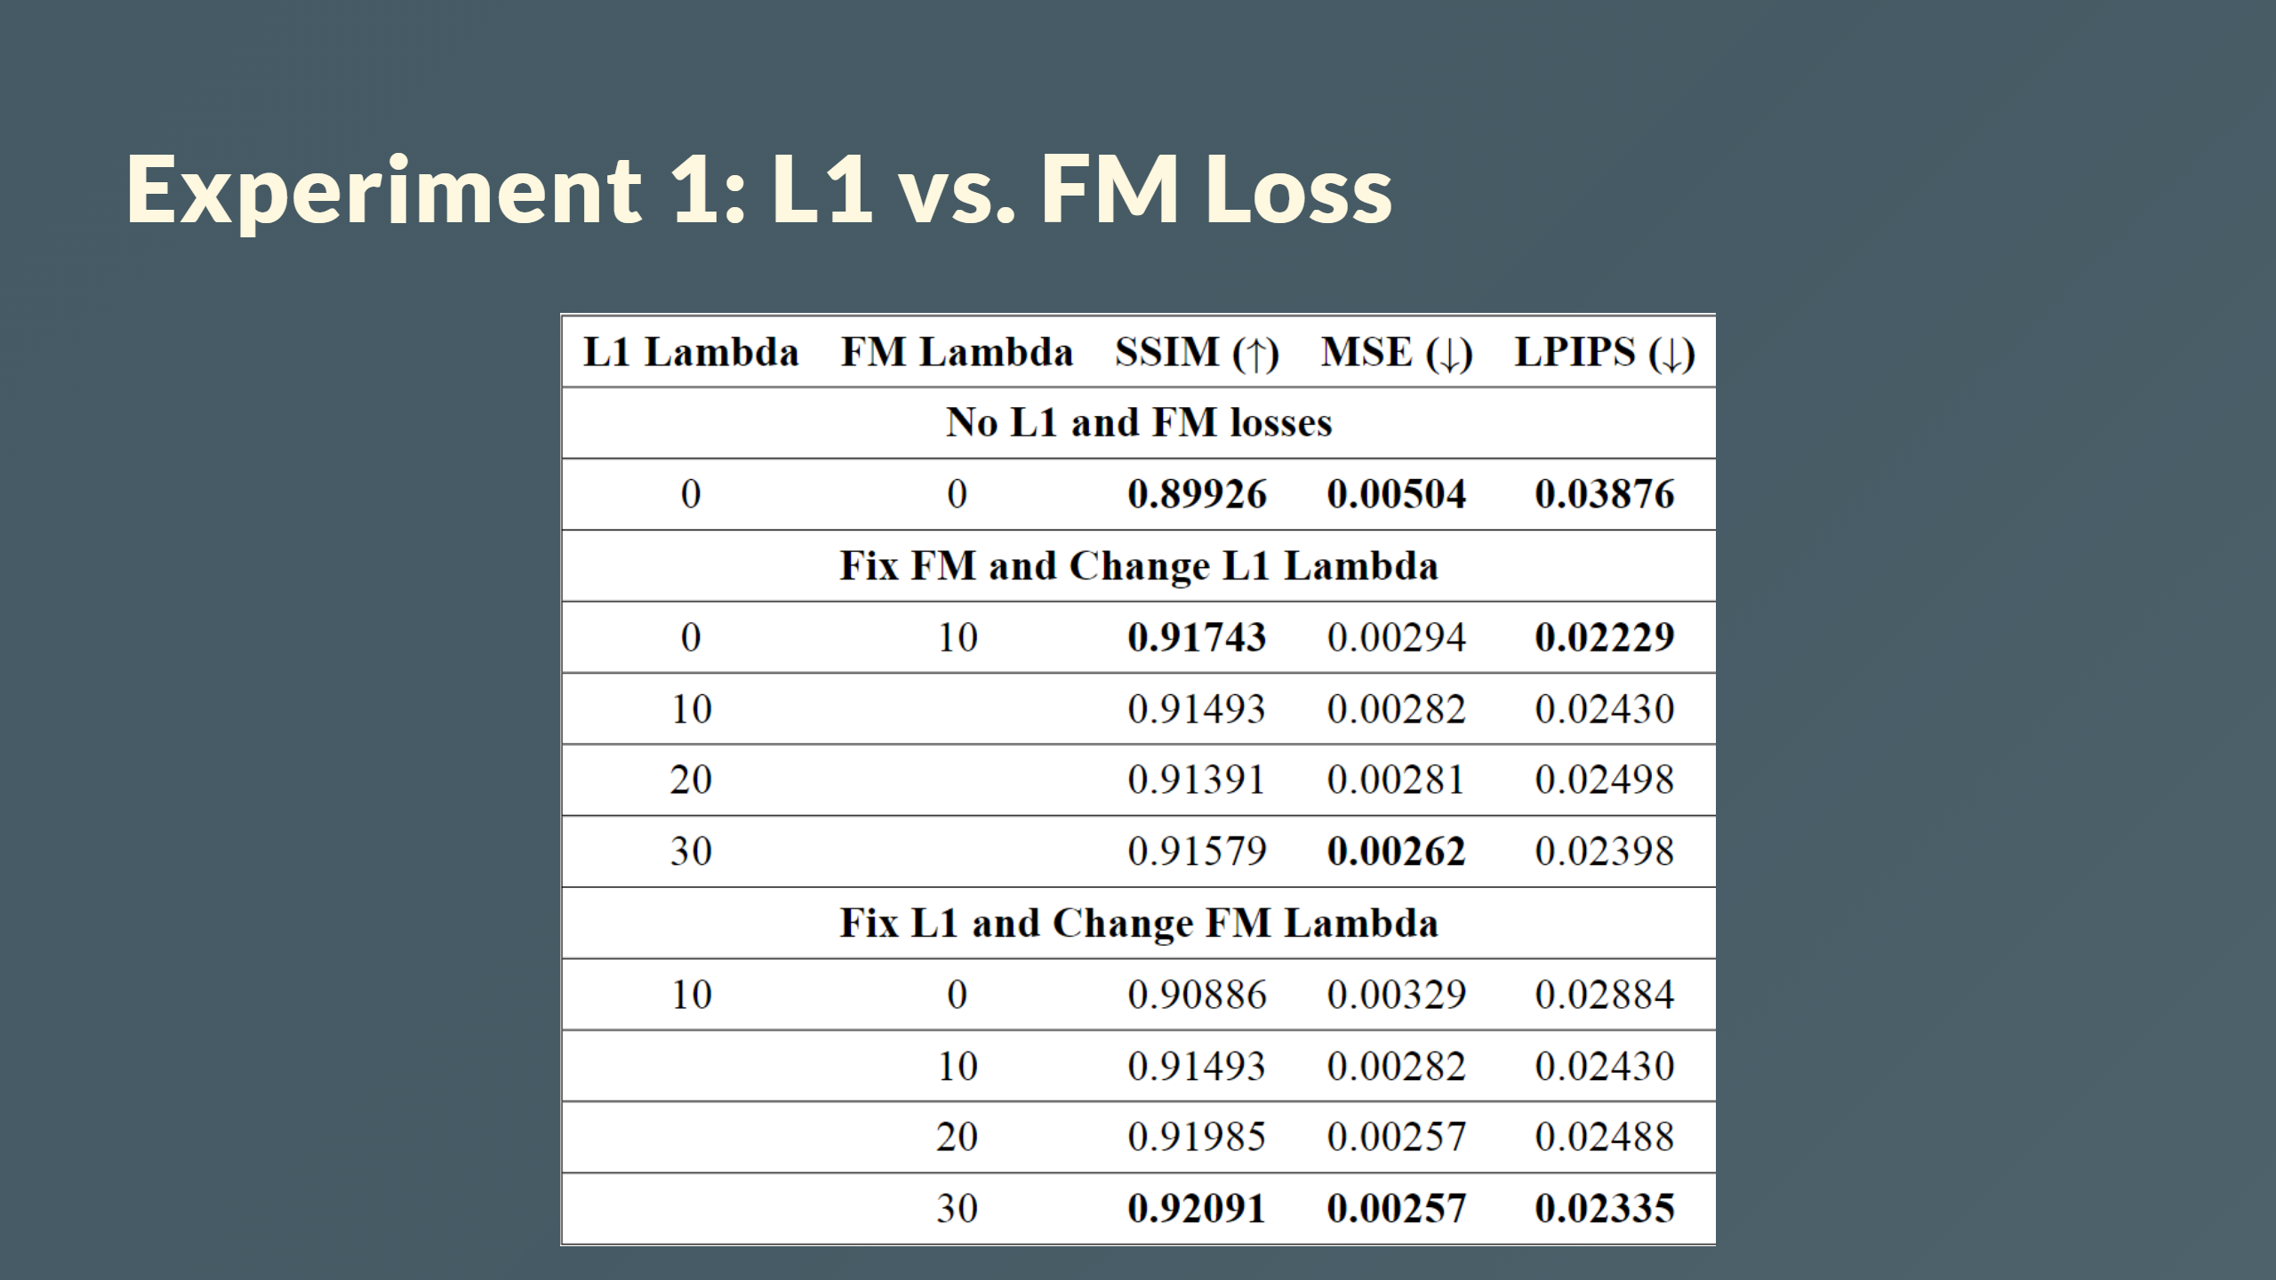

Slide 37
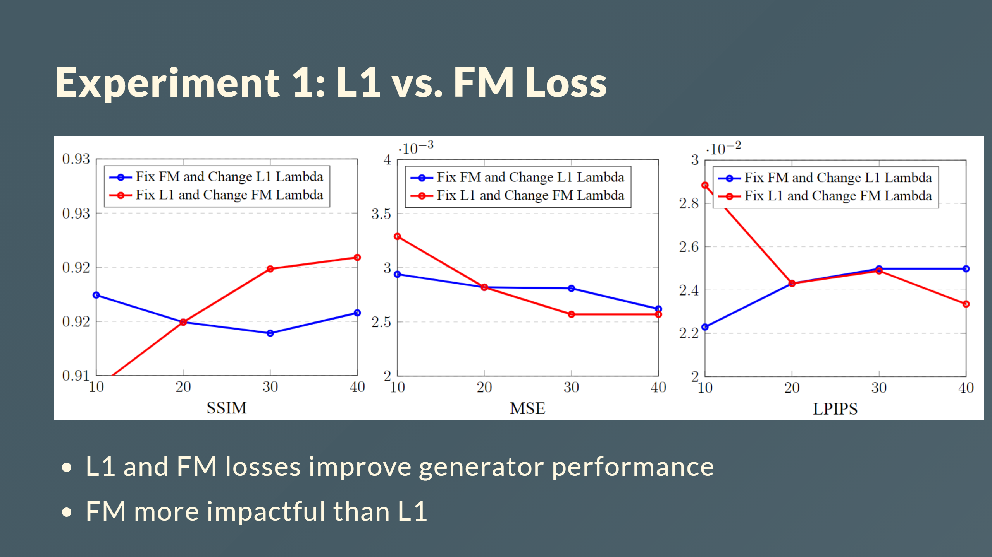

Slide 38
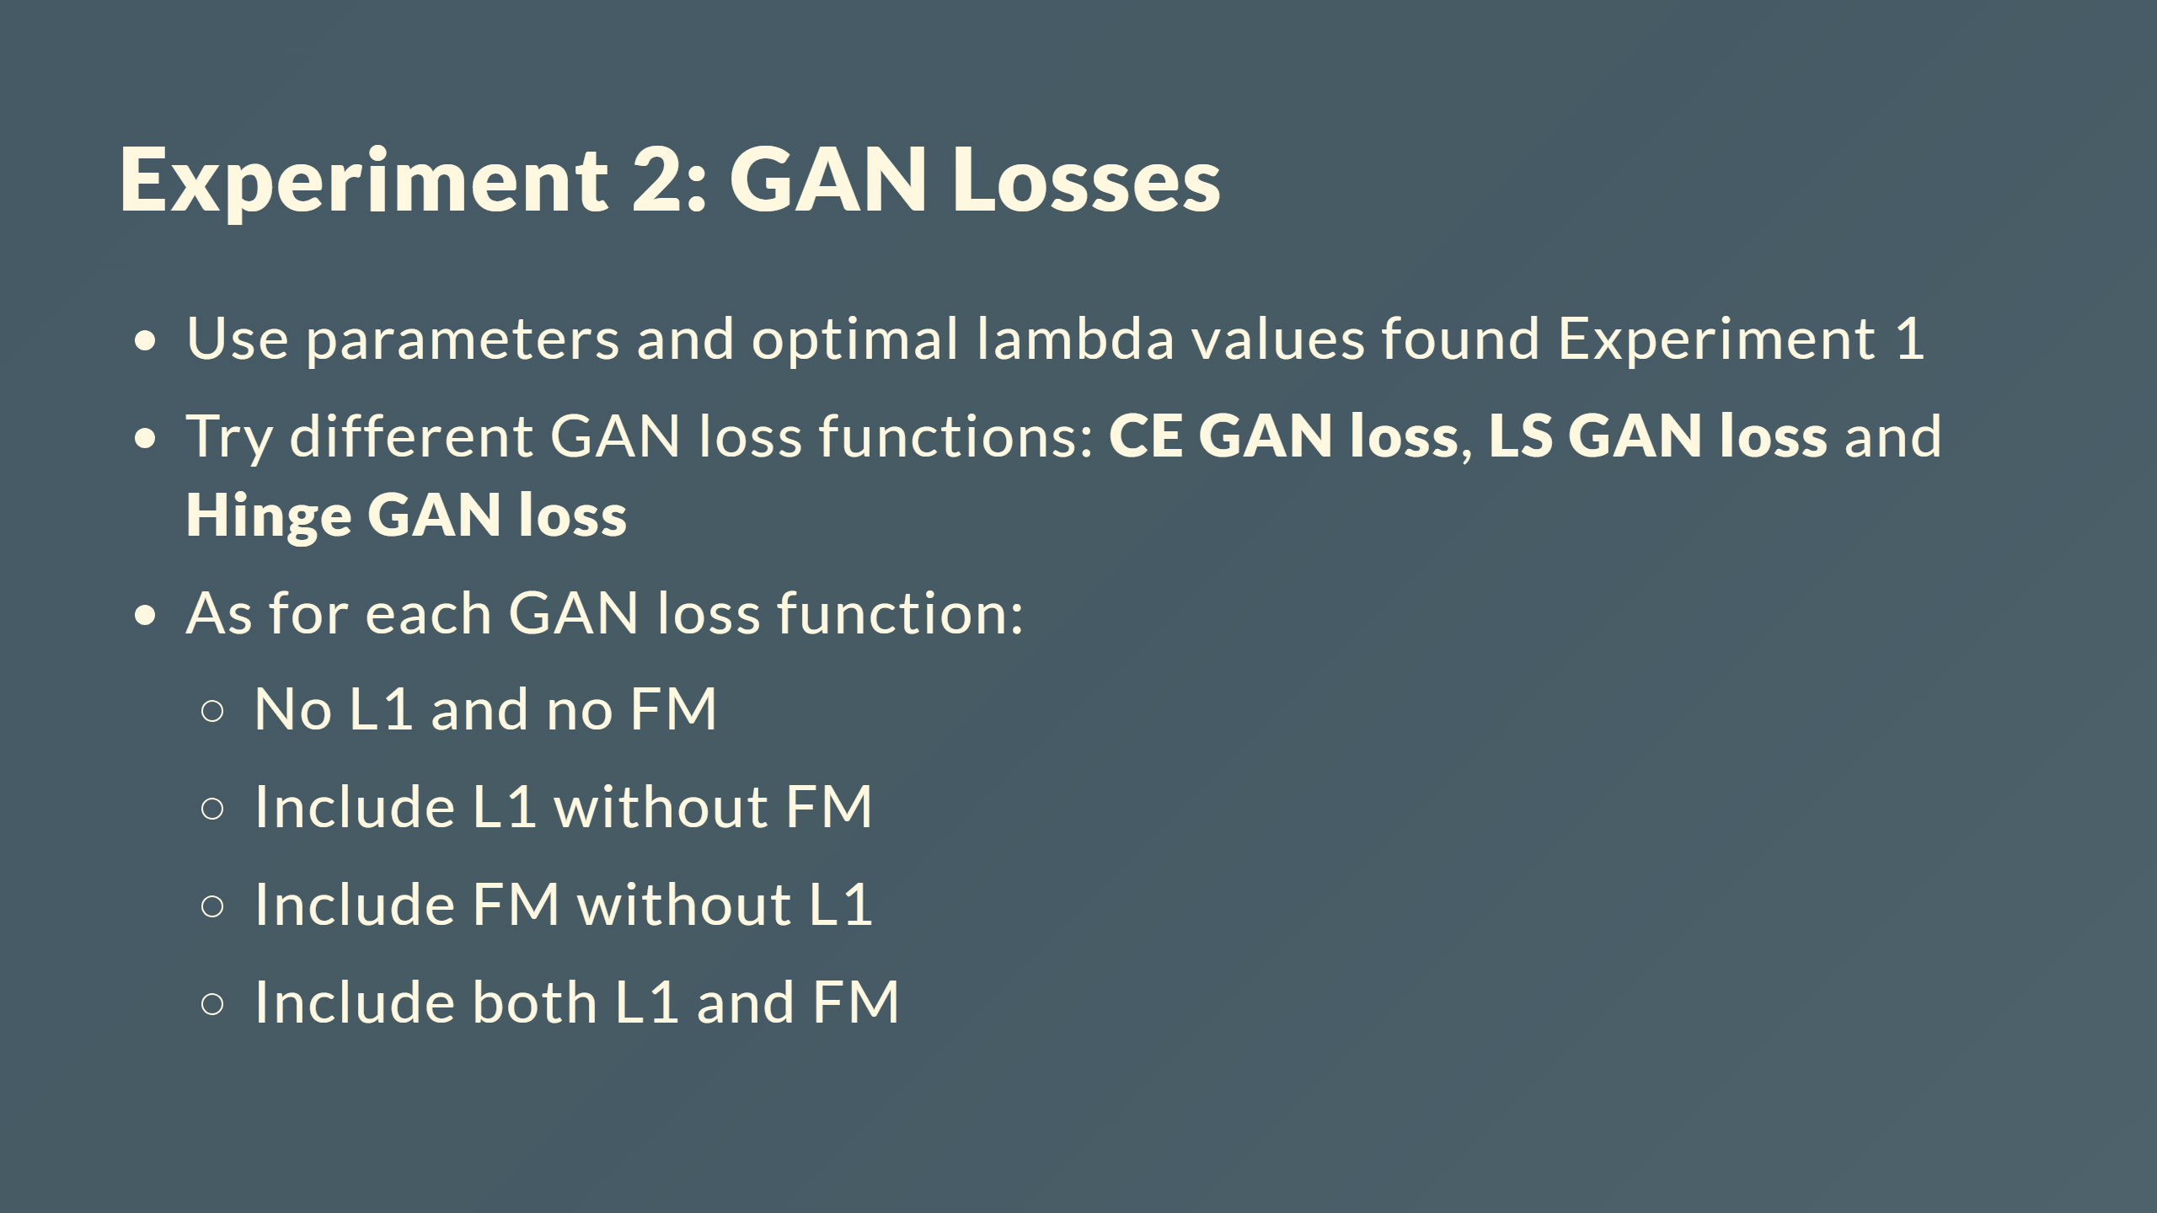

Slide 39
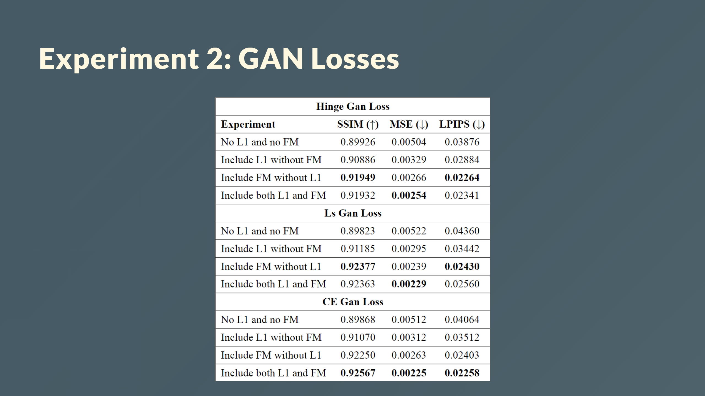

Slide 40
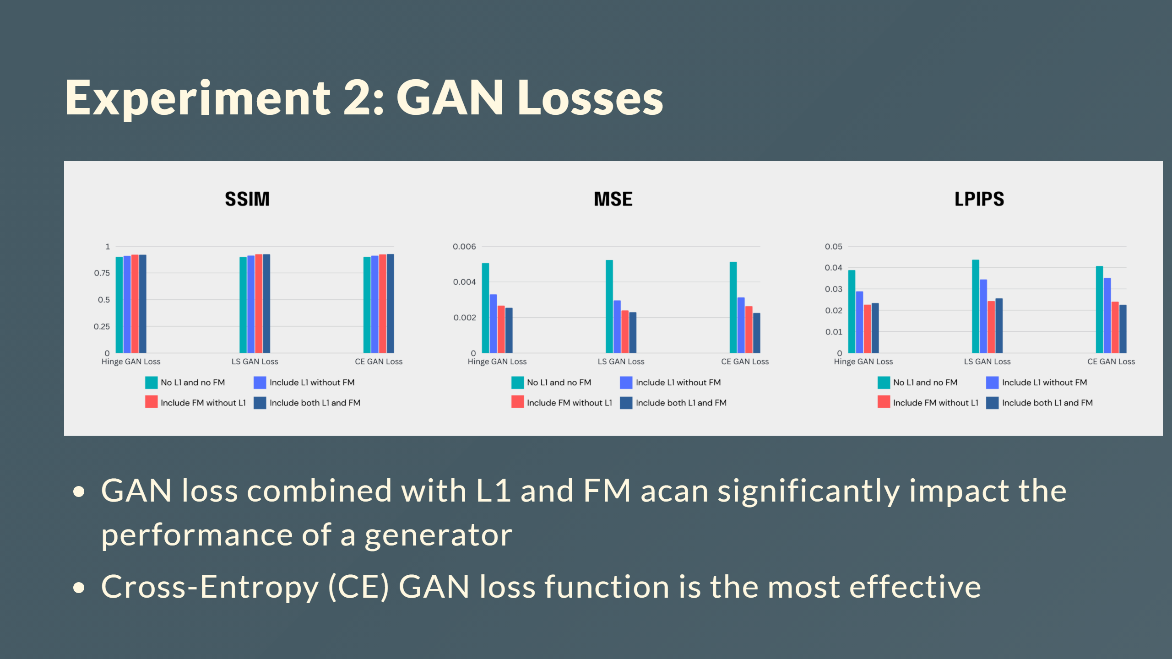

Slide 41
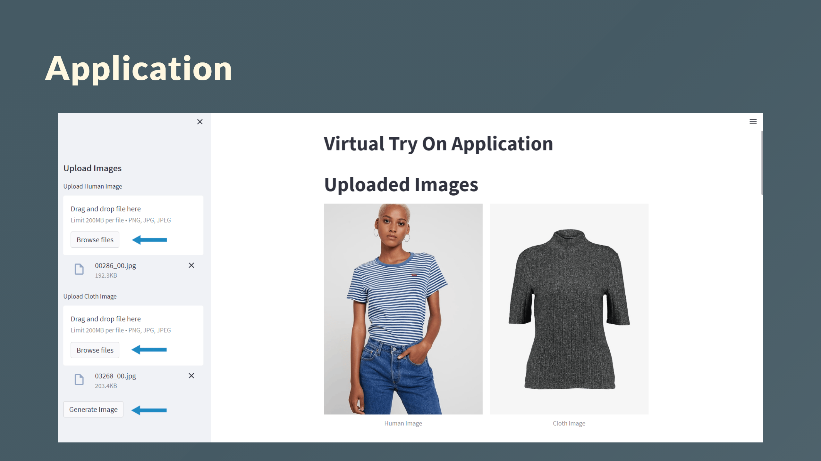

Slide 42
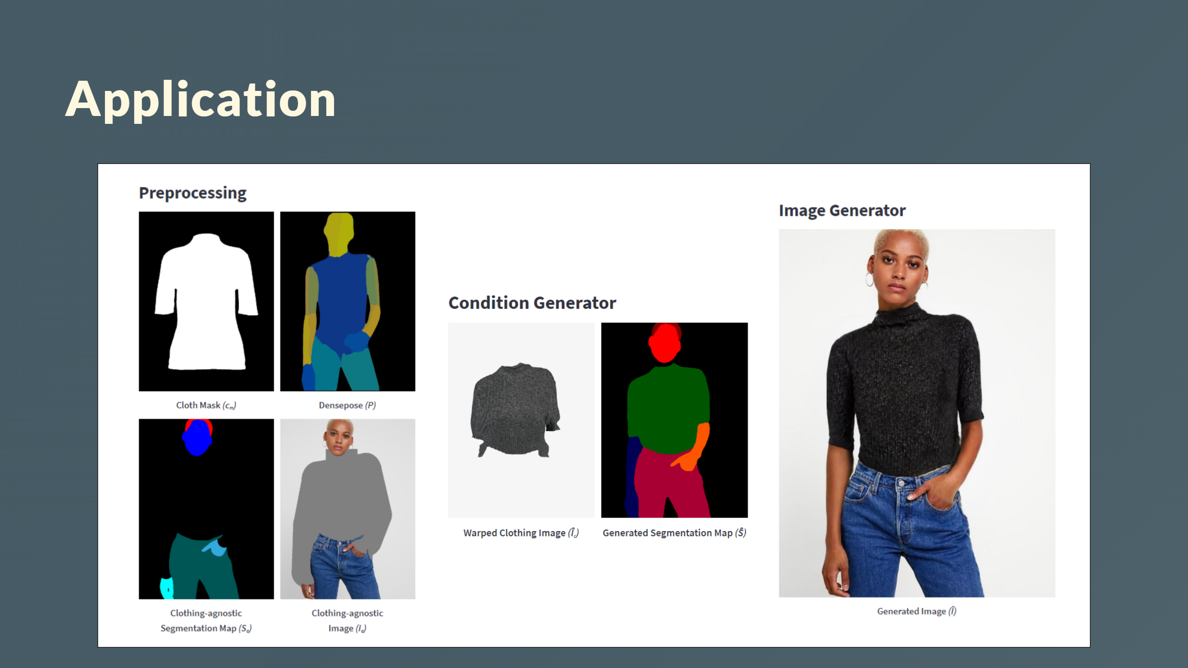

Slide 43
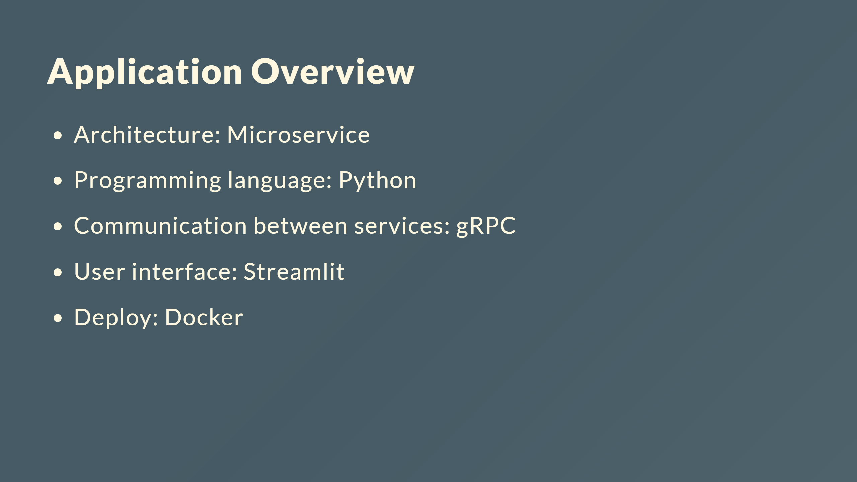

Slide 44
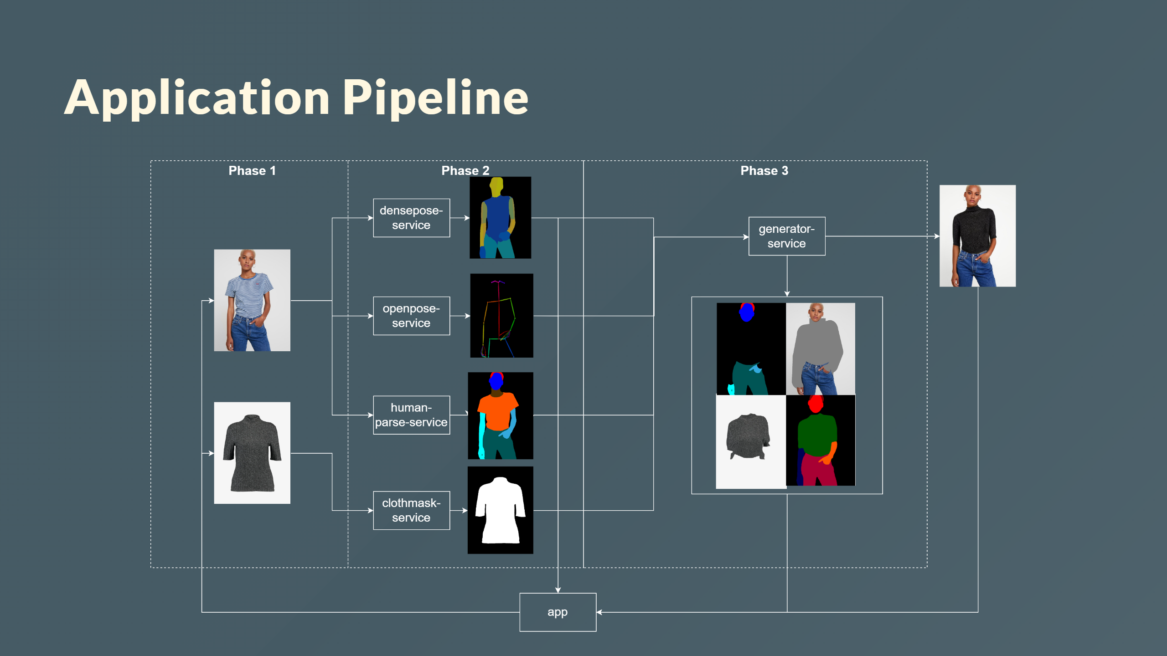

Slide 45
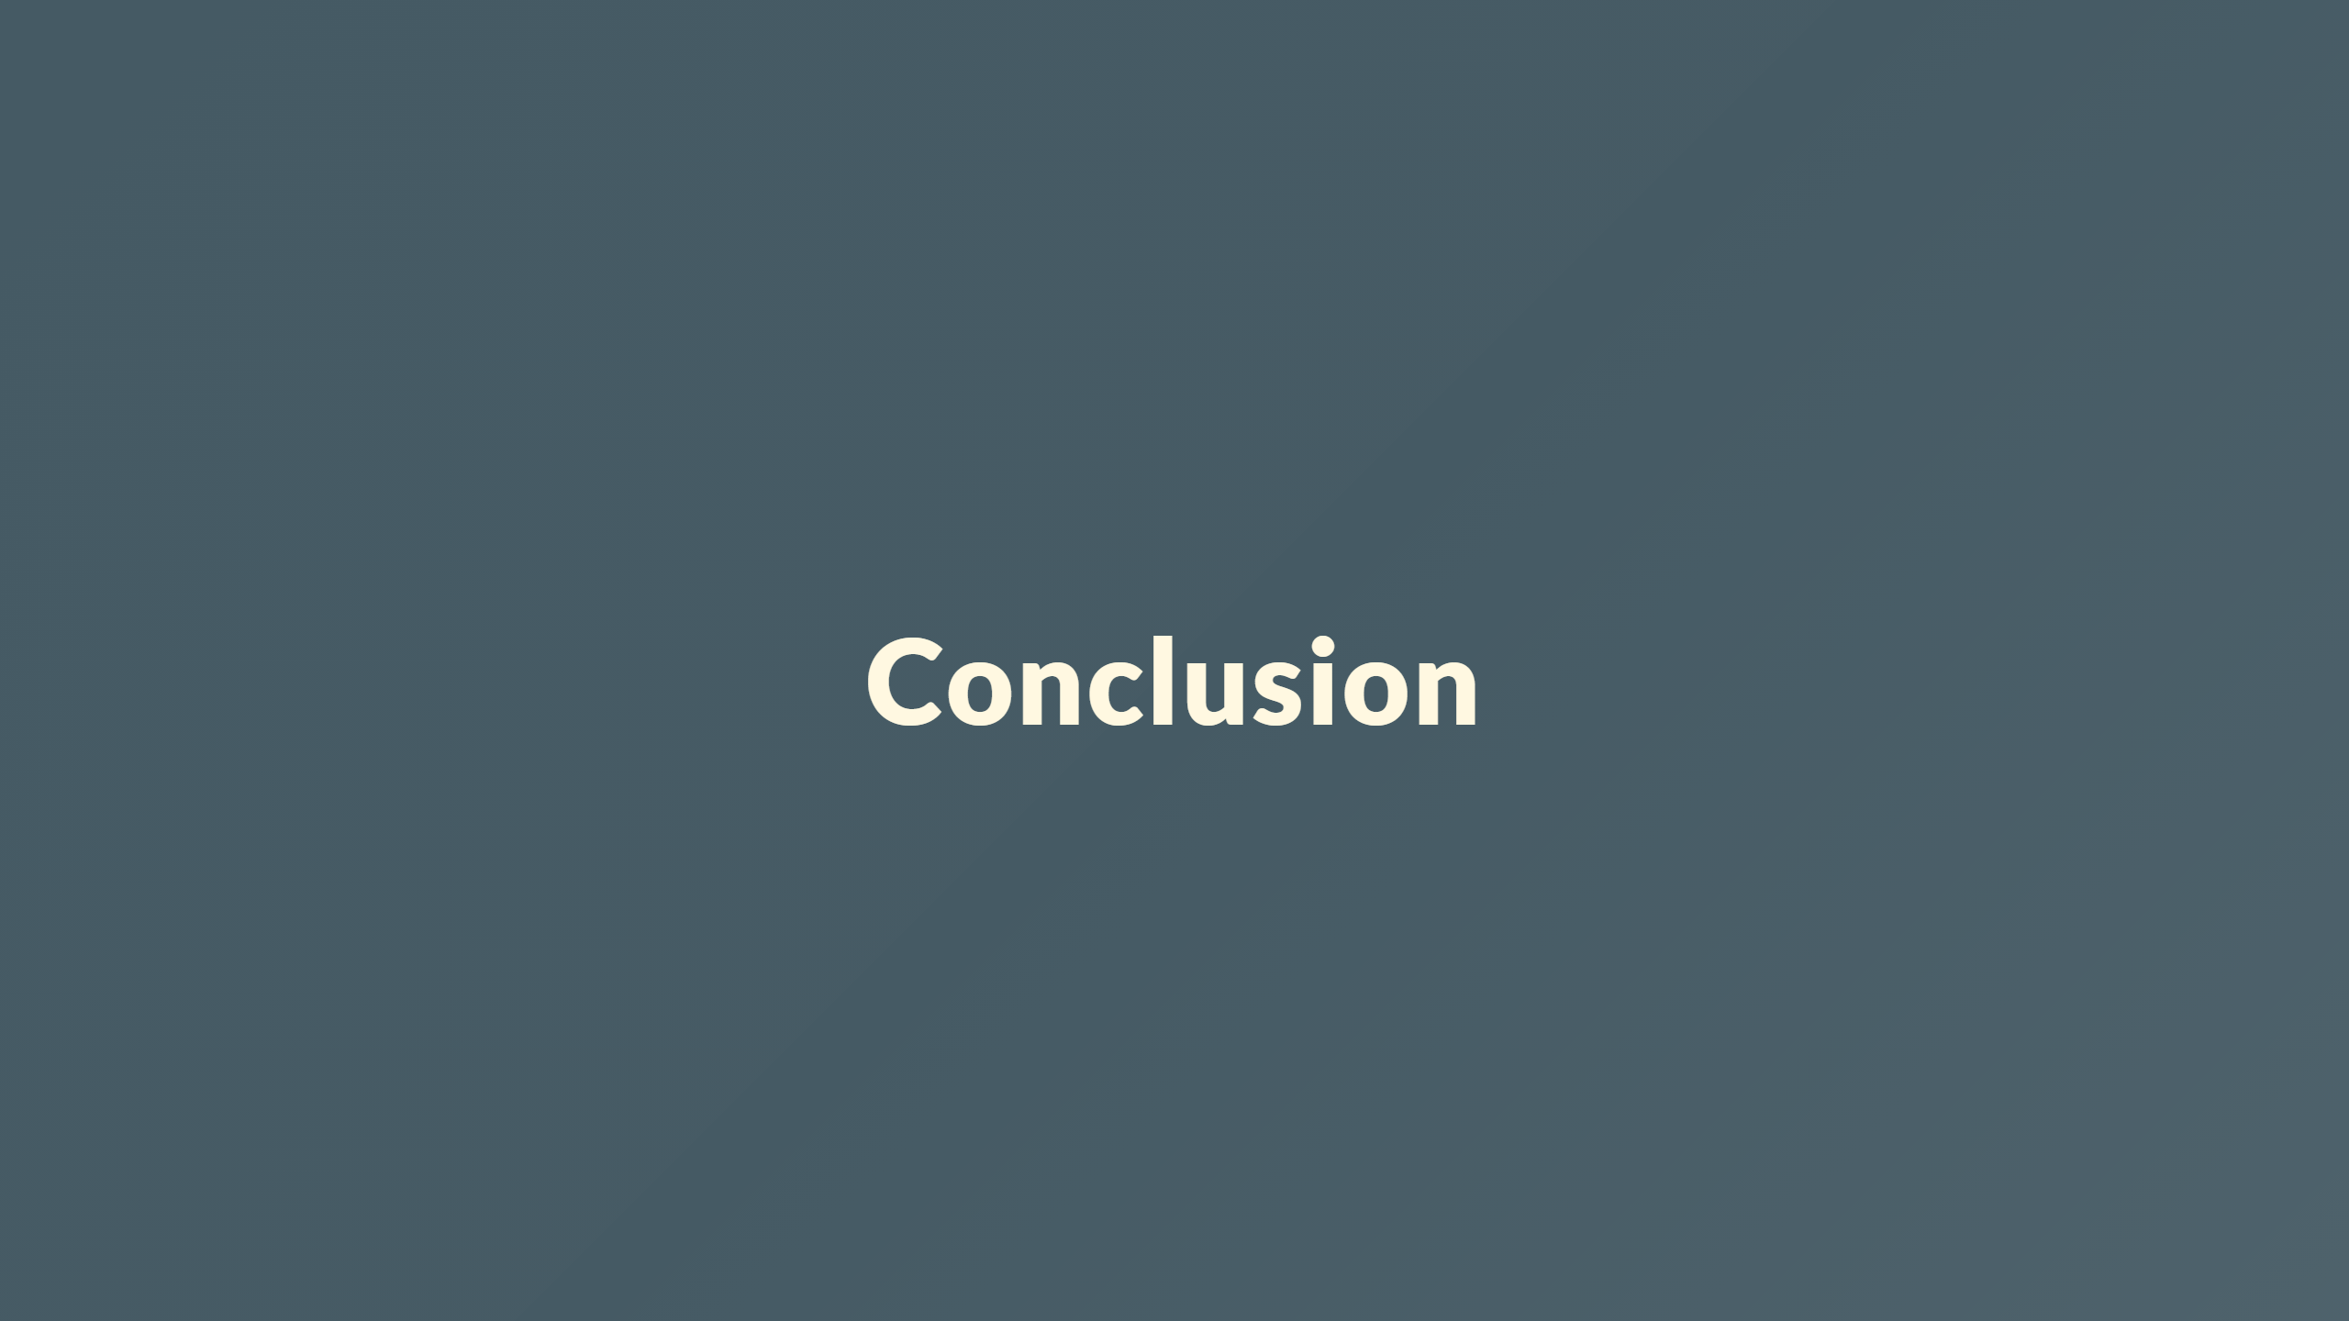
Notes:
## Discussion --- ## Limitations - HR-VITON model requires resource intensive for training. - Complex pre-processing. - Application works but slow runtime, particularly segmentation map of the human. - Pre-processing must match dataset ---

Slide 46
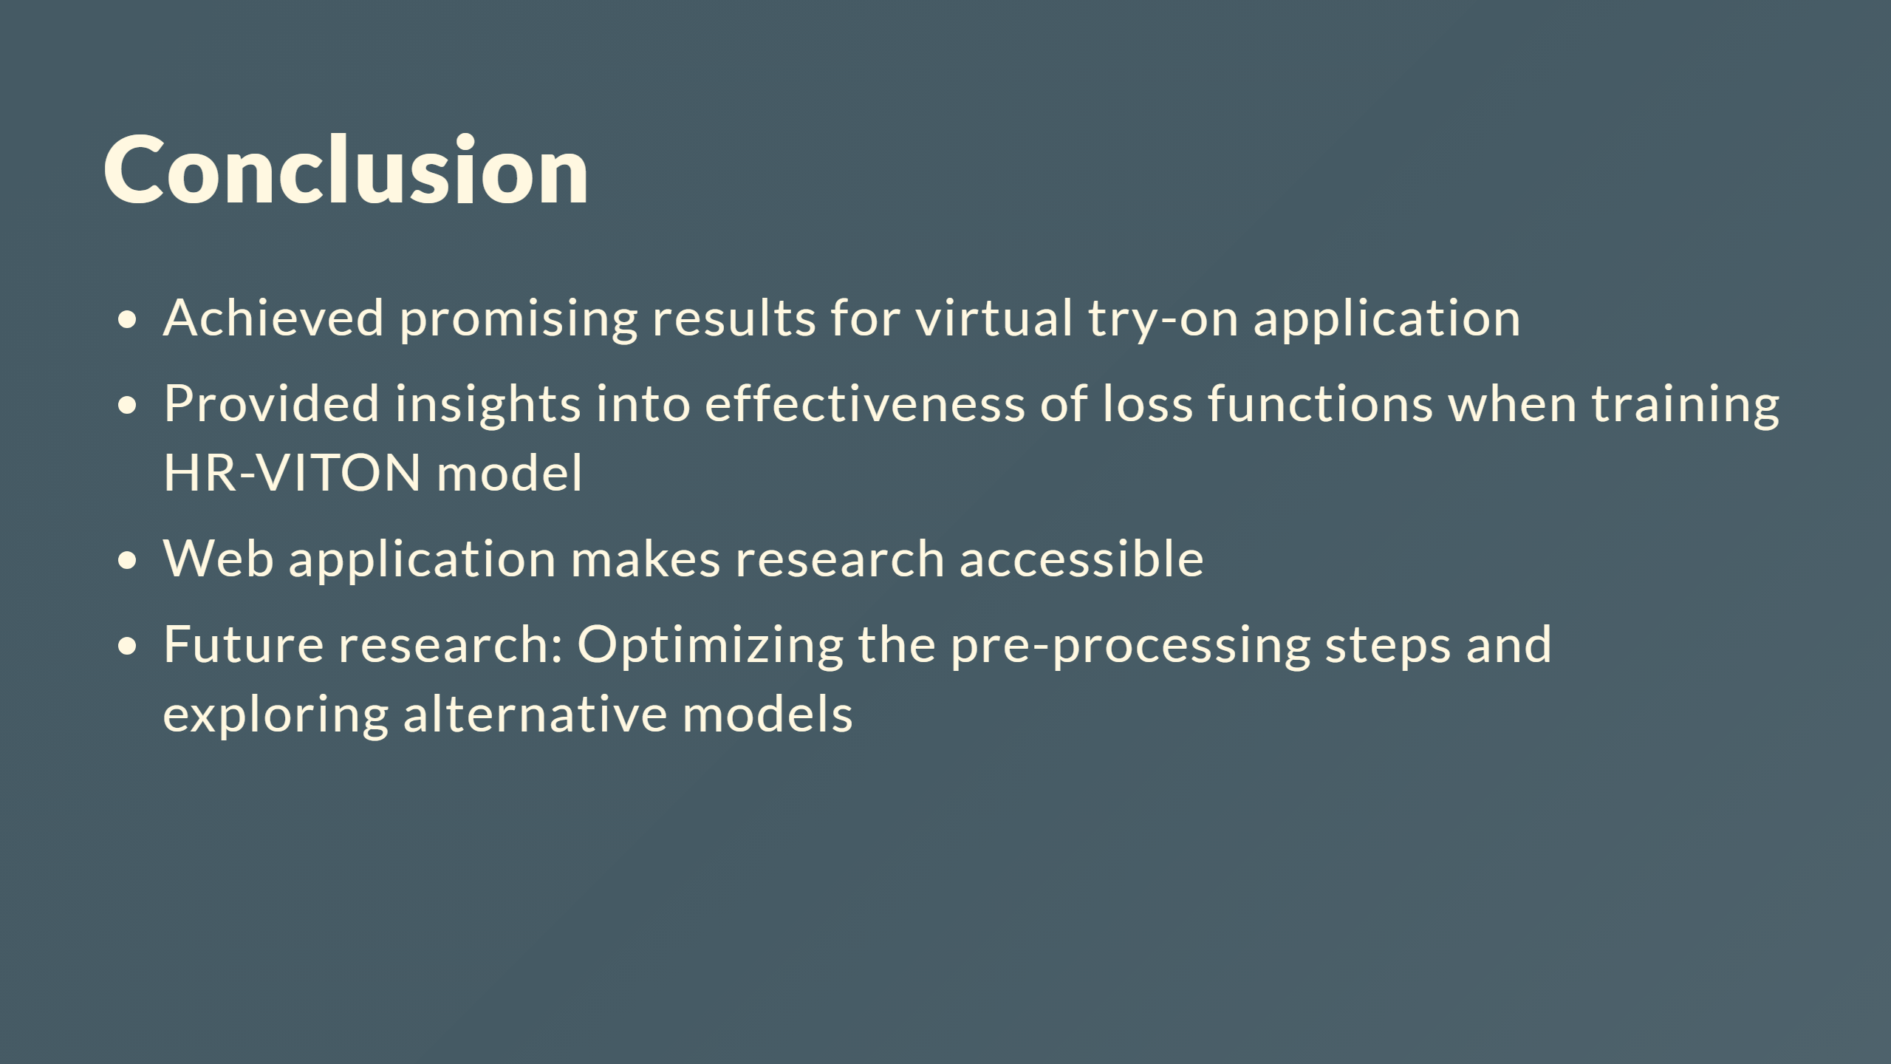

Slide 47
